Slide 1

Bringing you the history of DHC-3 Otter 54

Slide 2
The DHC-3 Otter 54 was a unique aircraft due to it being the only civilian Otter sold by DeHavilland Canada to South America.
The Otter was registered as HK-399 and rolled out of DeHavilland Canada on January 27th, 1955 with and was being delivered to Colombia by test Pilot Bob Fowler and technical representative Crawford Byers.

Slide 3
As this was the first Otter to go to South America we hoped to get its operation off to a good start; it was snowing on the 27th of January 1955 when we flew from Downsview, ON to Toronto International to clear Canadian customs and then clear US customs at New York’s Buffalo Airport.

Slide 4
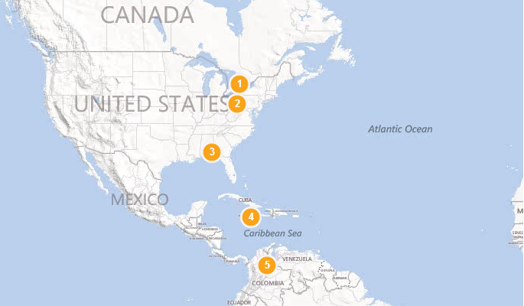

Slide 5
We departed Buffalo VFR in snow and headed to Pittsburgh Airport. We landed after dark, almost completely frozen since Otter 54 had no heater installed for its career in Colombia.
We flew the next day to Fort Rucker, Alabama home of the US Army Aviation Corps and stayed there January 28th and 29th to familiarize the US Army with the Otter, as they had just ordered these planes in quantity as the U-1A.”

Slide 7
After 2 nights in Miami, due to bad weather and heavy thunderstorms, we finally departed and flew to Kingston, Jamaica.
We were only able to land after several hours flying around the entire coast due to more bad weather and solid thunderstorms over the entire island.

Slide 8
On February 2nd, with both of us wearing a seat pack and a one-man dinghy, we set off for Barranquilla on the north coast of Colombia.
With one engine, the only thing of interest during the five hours of looking at the sea was a beautiful view of the 20,000’ snow covered peak of Santa Manta on the coast of Venezuela.
On February 3rd, 1955 we took off for Bucaramanga and, after searching for over an hour, we finally found it in a very rugged and smoky mountain country.

Slide 9
Total Trip: 2550 Miles

Slide 10
Taxi Aereo de Santander Ltda was formed in 1948 as an Air Taxi concern operating Stinson Voyagers & Cessna 180’s from the industrial capital Bucaramanga, in the north east portion of the province.
At the time, airfields in the area were too small for larger aircraft but with the Taxi Aero’s expansion program, three DHC-2 Beavers & this Otter were brought into the fleet.

Slide 11
In 1960, Taxi Aereo started purchasing larger aircraft like DC3’s and Curtis C46’s which they converted to passenger use. With larger aircraft in its fleet, it was decided to sell the Otter which was quickly purchased for US $44,000 by a bush pilot from Yellowknife named Robert Engle.

Slide 12
On November 29th, 1961 Robert Engle, with a ferry permit in his pocket and AME Denny McCartney by his side, started out on an 11 day - 3826 Mile trek to Field Aviations Calgary, AB operation.

Slide 13
They traversed from Bucaramanga, Colombia to:
Panama City
Costa Rica
Managua, Nicaragua
Tapachula, Mexico
Acapulco, Mexico
Mazatlan, Mexico
Ciudad Juarez, Mexico
El Paso, Texas
Albequerque, New Mexico
Denver, Colorado
Great Falls, Montana
and finally …
Calgary, Alberta (December 10th, 1961)

Slide 14
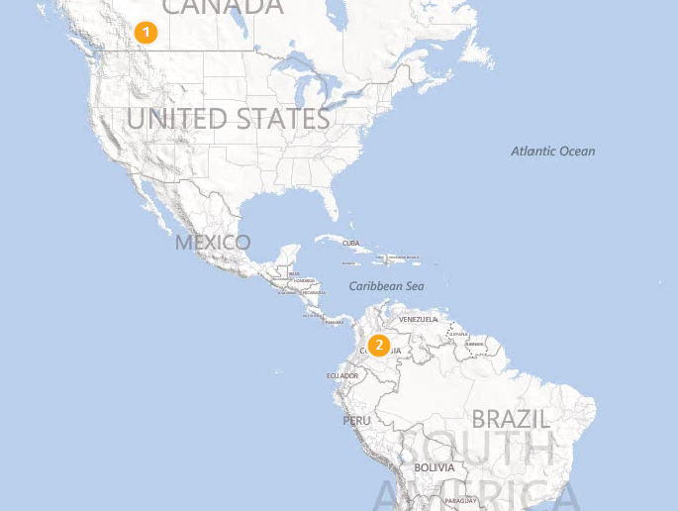

Slide 15
Robert Engle had started out flying Otter’s out of Yellowknife for Max Ward and one day in 1960 decided to strike it out on his own and formed:
Northwest Territorial Airway’s.
Robert Engle Canadian registered this Otter CF-NTR, which joined his DHC-2 Beaver and flew out of Canadian Pacific’s old waterfront building.

Slide 16
NTA graduated to Beech 18’s on floats, DC3’s, Lockheed L188 Electra’s and several jet aircraft becoming one of the major carriers in the Northwest Territories.
For most of the 60’s Otter CF-NTR was employed with NTA and had only suffered 2 accidents and no fatalities. Not bad for the amount of hours and terrain it flew in during this period.

Slide 17
The first accident happened in Yellowknife on September 13th, 1968 while the Otter CF-NTR was tied up to the company dock. Wardair’s Twin Otter CF-VOG was being taxied to the dock when its pilot “somewhat lost the run of his machine while attempting to arrest its forward motion and crashed into the Otter”.
The accident caused the Otters floats and tail plane to be damaged and crumpled one of its wings.

Slide 18
A year later, on August 1st, 1969 the Otter was involved in a more serious accident which ended its career for Northwest Territorial Airways.
Otter CF-NTR was engaged in water bombing a forest fire at Wholdaia Lake in the Northwest Territories.
The aircraft was climbing away from the lake after a water pick-up when at about 300 feet the engine quit with a loud bang.

Slide 19
The pilot immediately dumped the water load and turned back towards the lake.
Unfortunately, the Otter landed on the right float while still in a turn, causing it to bounce and stall then it struck heavily on the left float.
The float strut collapsed, the nose sank to the bottom of the lake and the otter flipped over and finally came to rest on its back in about 8 feet of water.

Slide 20
After crash #2, the salvage of the wreck was sold on July 12, 1970 to Minto Airways Inc.
They applied to have the Otter registered again, but were declined due to the fact that it needed to be repaired, inspected and then certified. The Company did not proceed any further with the plane.
Minto Airways sold the Otter on September 10th, 1971 to Western Rotorcraft Ltd. who specialized in converting planes to turboprop power.

Slide 21
Western Rotorcraft US registered the Otter N3904 and started the rebuild project.
They wanted to do an engine conversion with a Garrett Air Research TPE-331-151A Turbine Engine and become the first Turbine Otter in existence.
It appears, however, that the testing in 1972 did not go well at Lake Union, Seattle and that the concept of a Turbine Otter was way ahead of its time.

Slide 22
After testing concluded in July, 1972 the Turbine engine was removed and N3904 was left parked at Arlington Airport until April, 1974 when it was trucked to Kenmore Air.
Kenmore performed a major airframe overhaul (TAT 7,694 hrs) for Western Rotorcraft and the standard Pratt & Whitney R1340 piston engine was re-installed.

Slide 23
On April 12, 1976 Western Rotorcraft sold N3904 to Harold Bradfelt of Sioux Falls, South Dakota who was associated with Western Rotorcraft during their work on the Otter.
On December 13, 1976 Harold Bradfelt sold N3904 to Kachemak Air Service Inc. located in Homer, Alaska.
This would be N3904’s base for the next 24 years.

Slide 24
The winter of 1976, N3904 was flown to Wickenburg, Arizona by Kachemak Air Services owner, William de Creeft, where it was repainted by Avart.
It was painted into the most attractive overall red scheme with a black speed line, which it was to wear from then on and why it was know as “Big Red”.

Slide 25
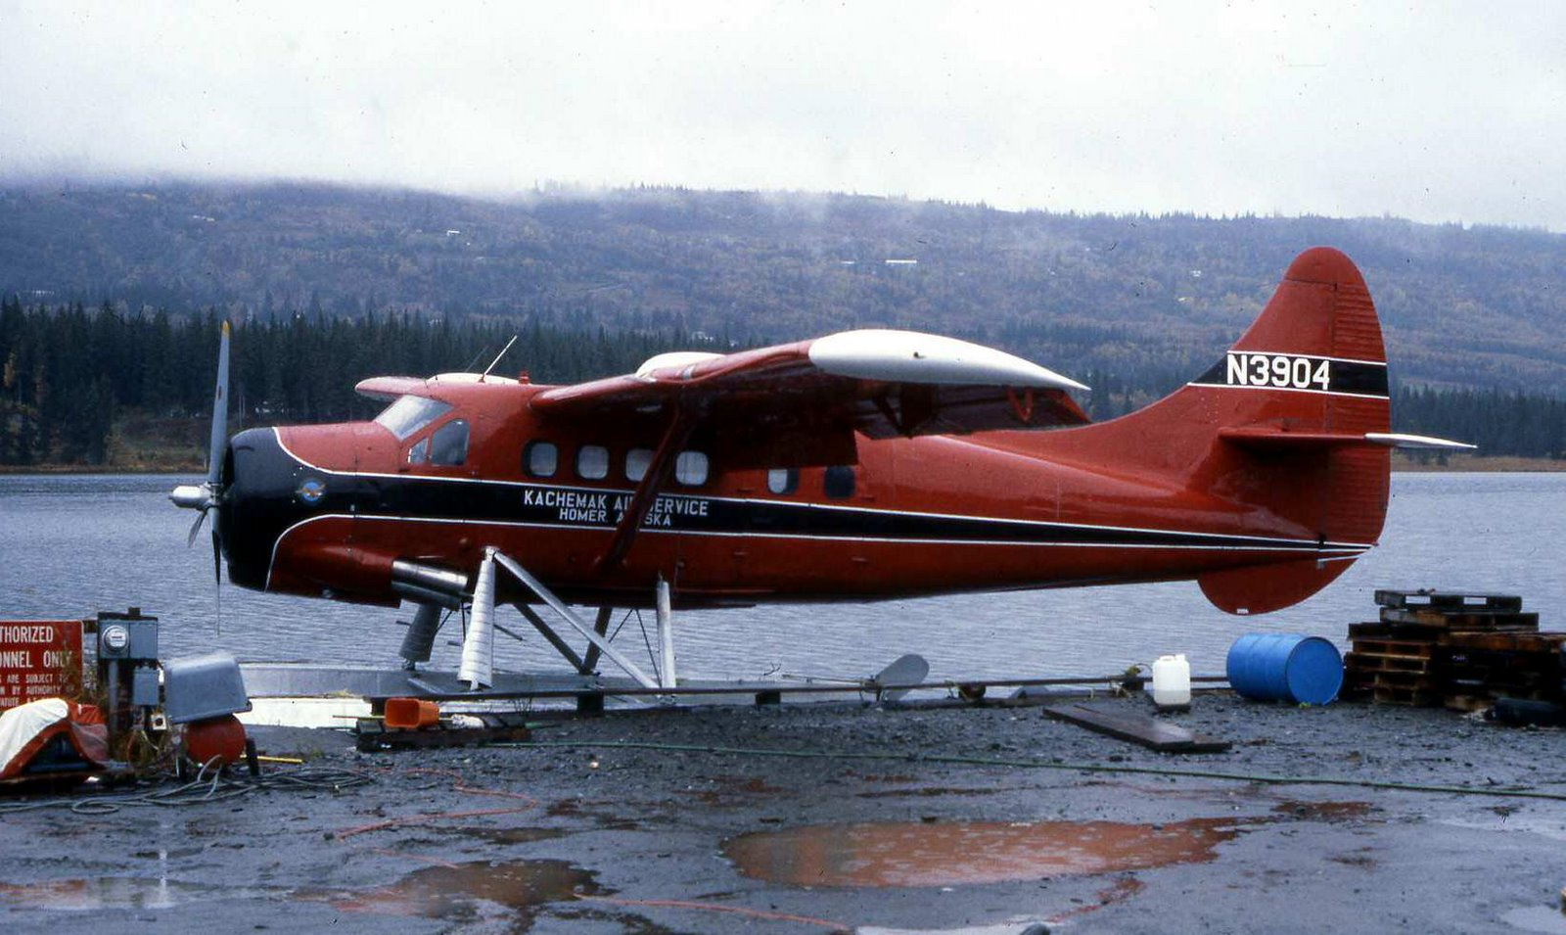

Slide 26
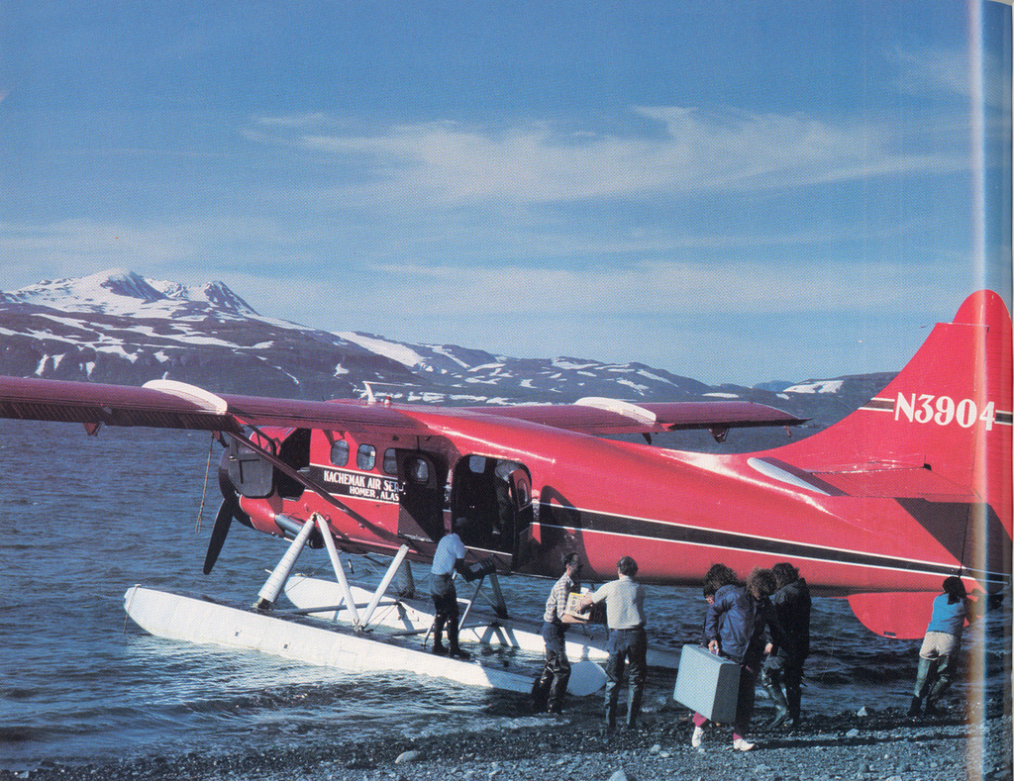

Slide 27
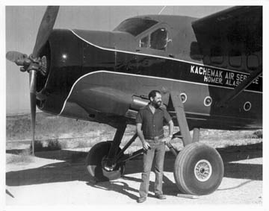
Bill de Creeft with Big Red

Slide 28
N3904 then flew back to Homer, Alaska and into service with Kachemak Air.
A major source of business for the Otter was the local fishing industry, ferrying fisherman to and from the outlying fishing grounds.
Pilot Bill de Creeft transported many fishermen in the late 1970’s and subsequently their children and grand-children, so long as the Otter was in service.

Slide 29
During its service in Alaska, N3904 was involved in the support of the native villages & oil industry, supplying Fish & Game personnel, government scientists, geologists, exploration and logging camps with food and fuel and often moved these camps from place to place.
N3904 serviced the needs of the bush country for hundreds of miles around Homer, Alaska and occasionally went further afield performing medavac flights to outlying towns.

Slide 30
As the years passed by demand for this type of general charter were reduced and support of the tourist industry became the primary source of business.
Building materials were flown into sites where camps and lodges were being made.
As the company’s website informed:
“Big Red carried every stick of lumber, every brick and every piece of furniture to build and furnish the delightful Loonsong Lodge”.

Slide 31
N3904 was used for brown bear viewing on the McNeil River and transported hunters, fishermen, backpackers, kayakers and general cargo throughout the region.
During the 1990’s however, Kachemak Air found it difficult to continue operations profitably with the 2 DeHavilland’s and decided to sell their Beaver.

Slide 32
I guess they felt they would get a better price for a Beaver ……
then an Otter!!!

Slide 33
In November of 2000, N3904 was taken from Beluga Lake for the last time and put on wheels in preparation for sale.
One month later, N3904 was sold, an event which made the local media.
The Homer Alaska News reported “Big Red is gone, Pilot Bill de Creeft has sold the Otter he has owned and operated since 1976. Others will continue to service us but, De Creeft was a familiar sight and even something of a flying landmark, drawing the attention of Homer residents and visitors alike”.

Slide 34
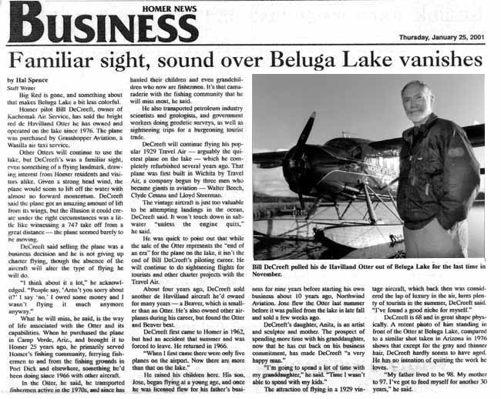

Slide 35
The otter was sold to Chinook Air of Fairbanks and moved to its new base in Wasilla, north of Anchorage, where Grasshopper Aviation used it to service a lodge for the next two years.
On December 28, 2002 Otter N3904 crashed in Nikolai, AK. The accident happened as the Otter was taking off empty for the return flight to Wasilla.

Slide 36
The pilot reported that he had an uneventful take-off from the 1000’ by 30’ snow covered airstrip and then climbed to about 800’ with airspeed increasing to 55 knots.
The pilot then heard a very loud bang followed by a loud rattling noise.
The pilot attempted to turn N3904 around and return to the airstrip.

Slide 37
With considerable difficulty, he was able to manoeuvre the Otter using a combination of aileron control and the remaining amount of rudder control.
As he passed over the approach end of the airstrip, the aircraft drifted to the right and he initiated a go-around.
The Otter subsequently collided with a stand of trees on the north side of the airstrip and sustained substantial damage.

Slide 38
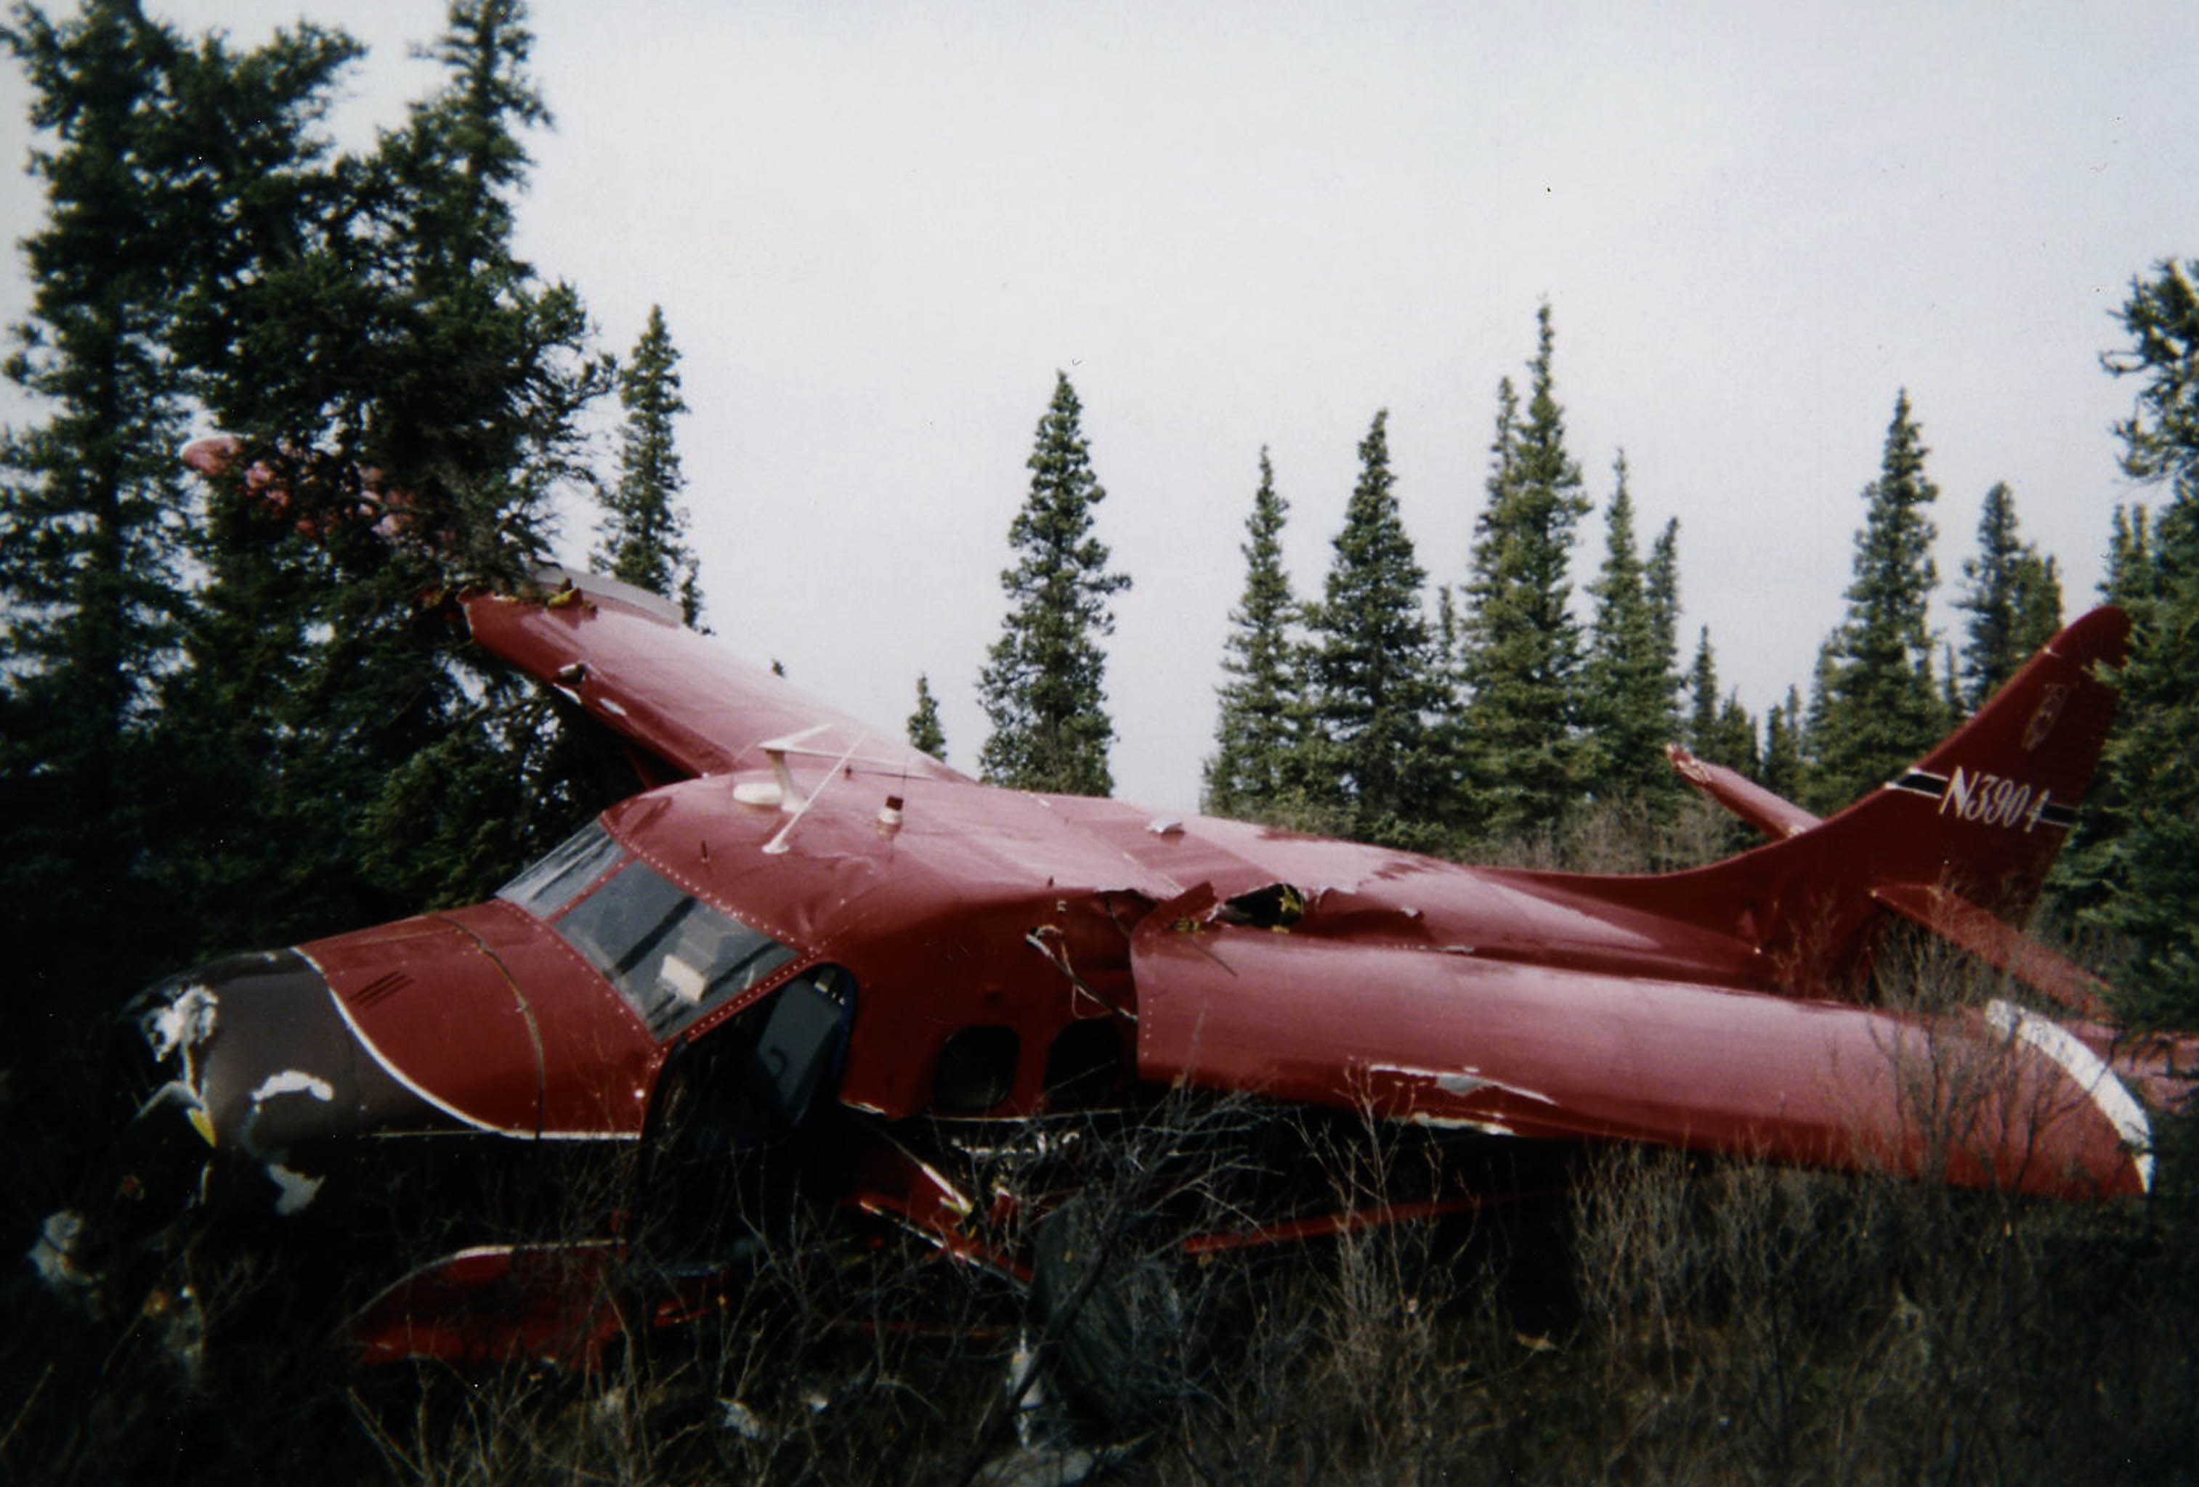

Slide 39
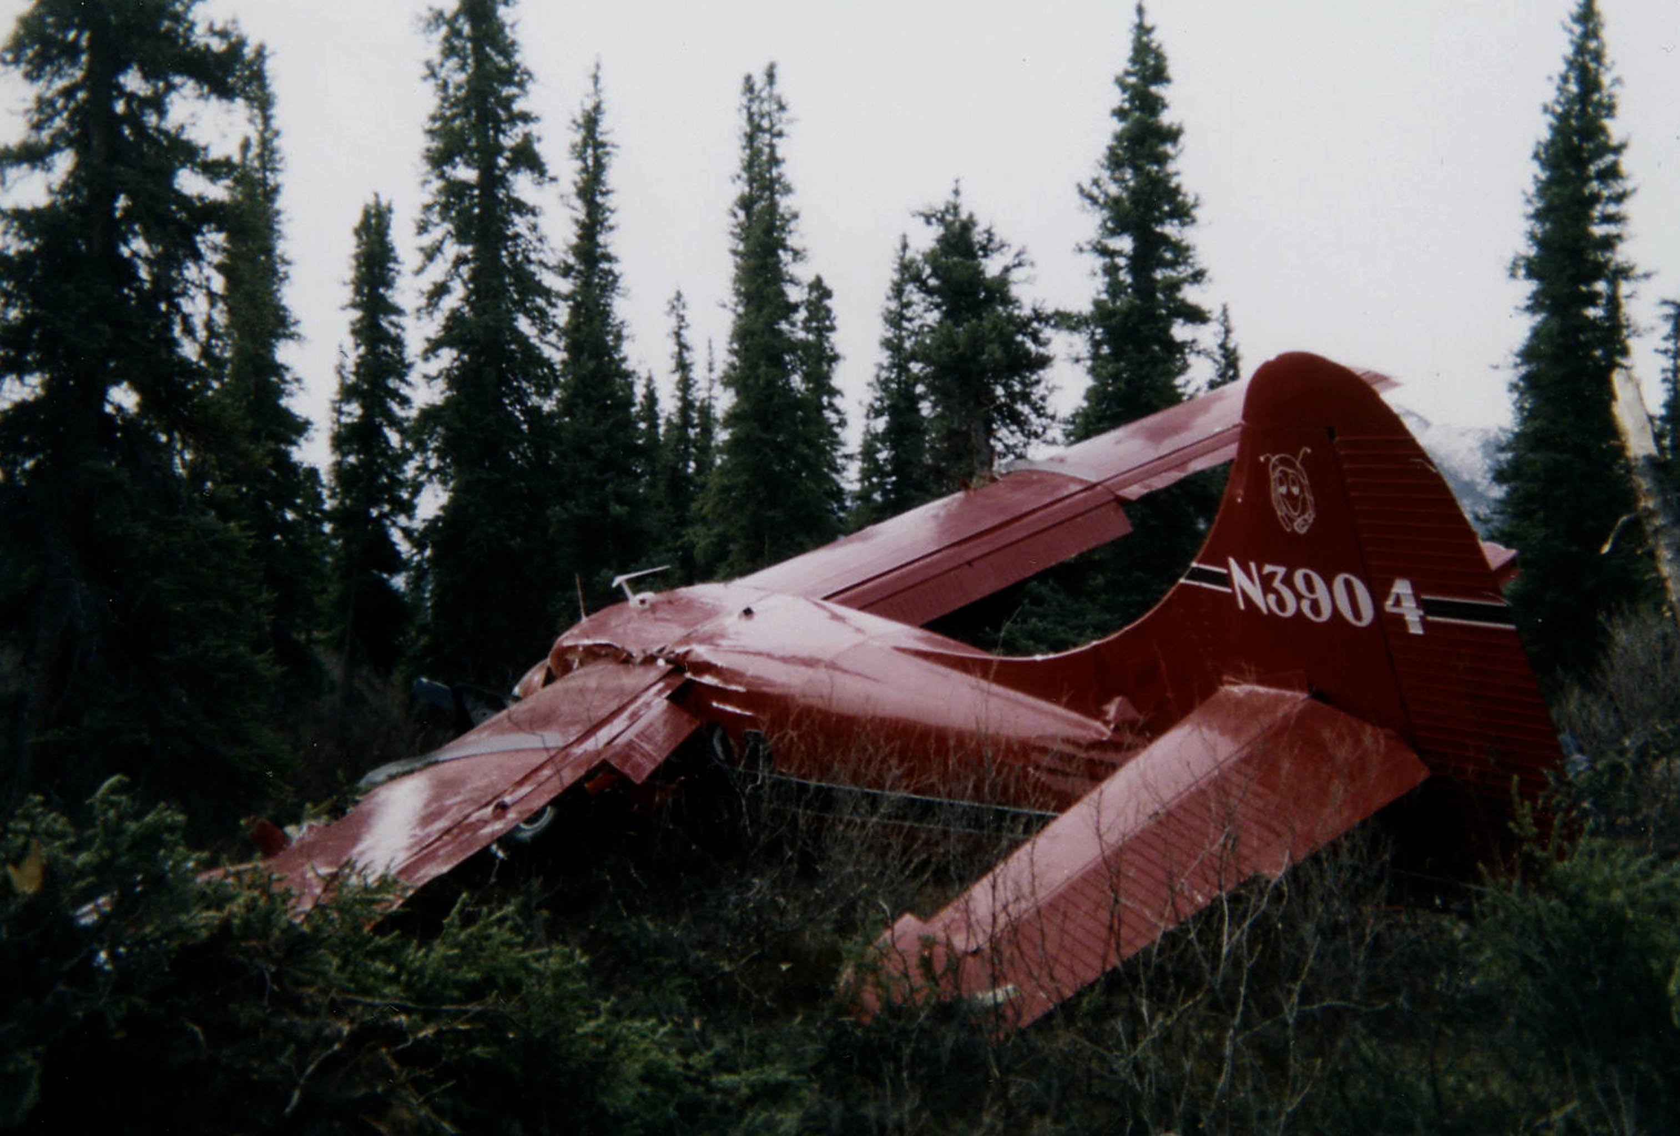

Slide 40
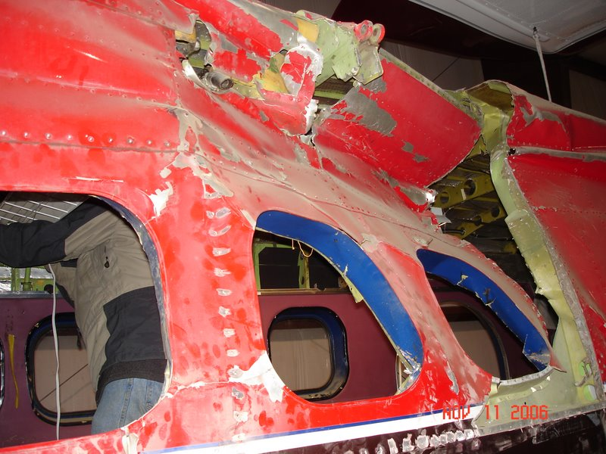

Slide 41
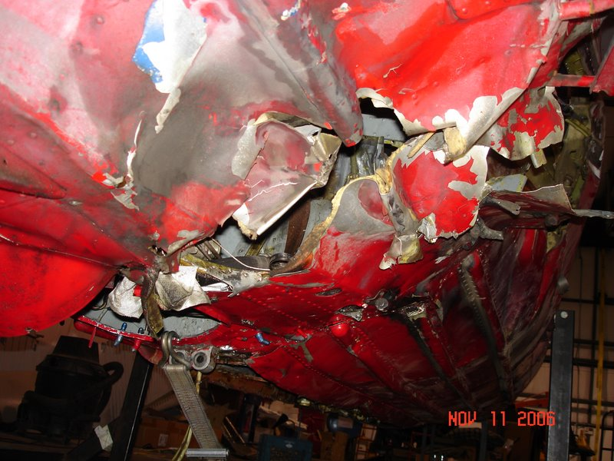

Slide 42
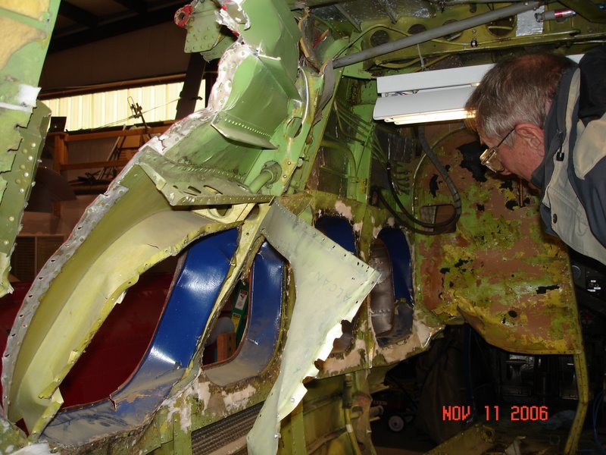

Slide 43
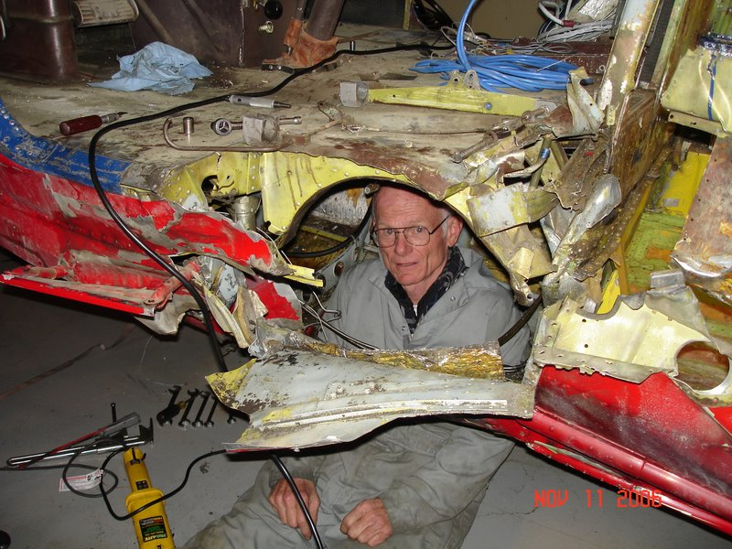

Slide 44
The Otter was bought from the insurance company by Ed Tuohy of Tuscon, AZ.
On October 1, 2005 he sold the rebuild project to Carl Penner & Richard Fowler who trucked it to their hanger in Heber, Utah.

Slide 45
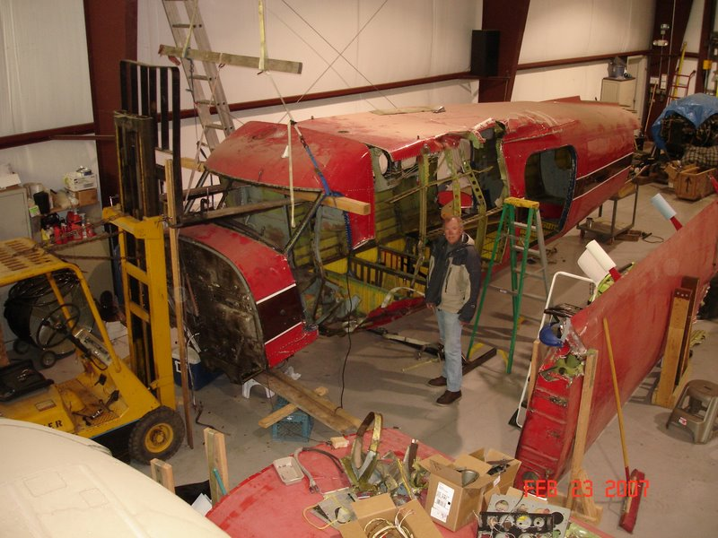

Slide 46
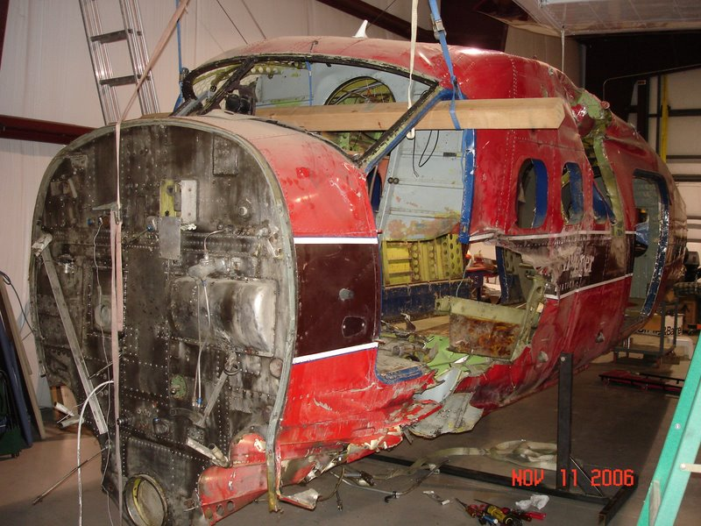

Slide 47


Slide 48
After several years of purchasing various parts for the rebuild, Carl Penner & Richard Fowler made a partnership deal with the late Doug Waugh from Arctic Aerospace & Stolairus Aviation to complete the rebuild of N3904.

Slide 49

The following pictures have been taken over the past 2 years to show the rebuilding progress of Otter 54.
Not only have we rebuilt this Otter but we have brought a piece of history back into the present.

Slide 50
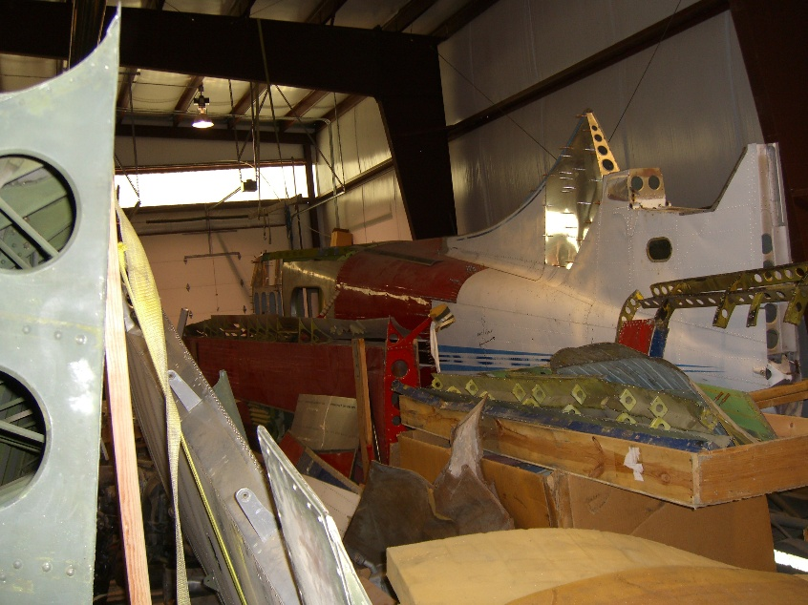
What we had to work with…

Slide 51
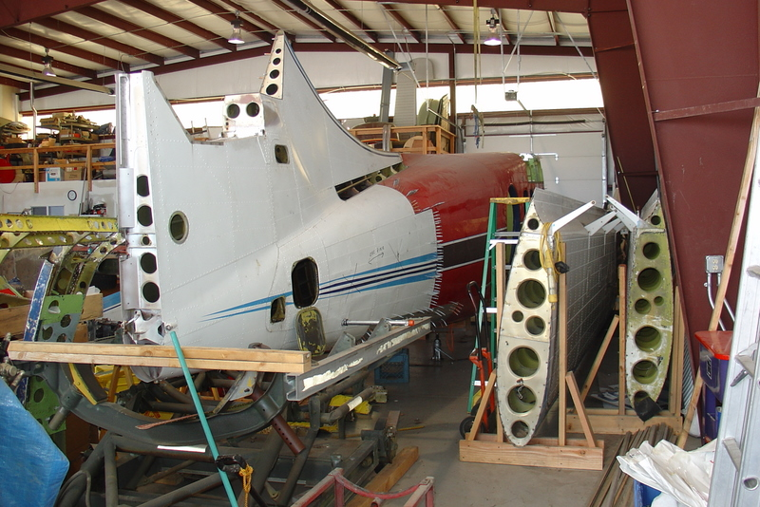

Slide 52
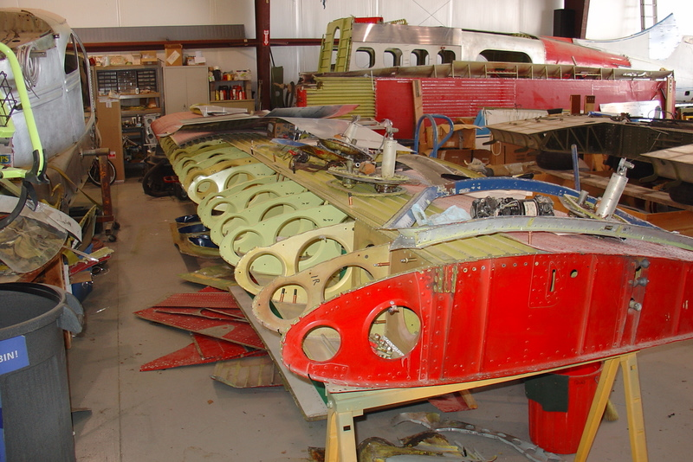

Slide 53
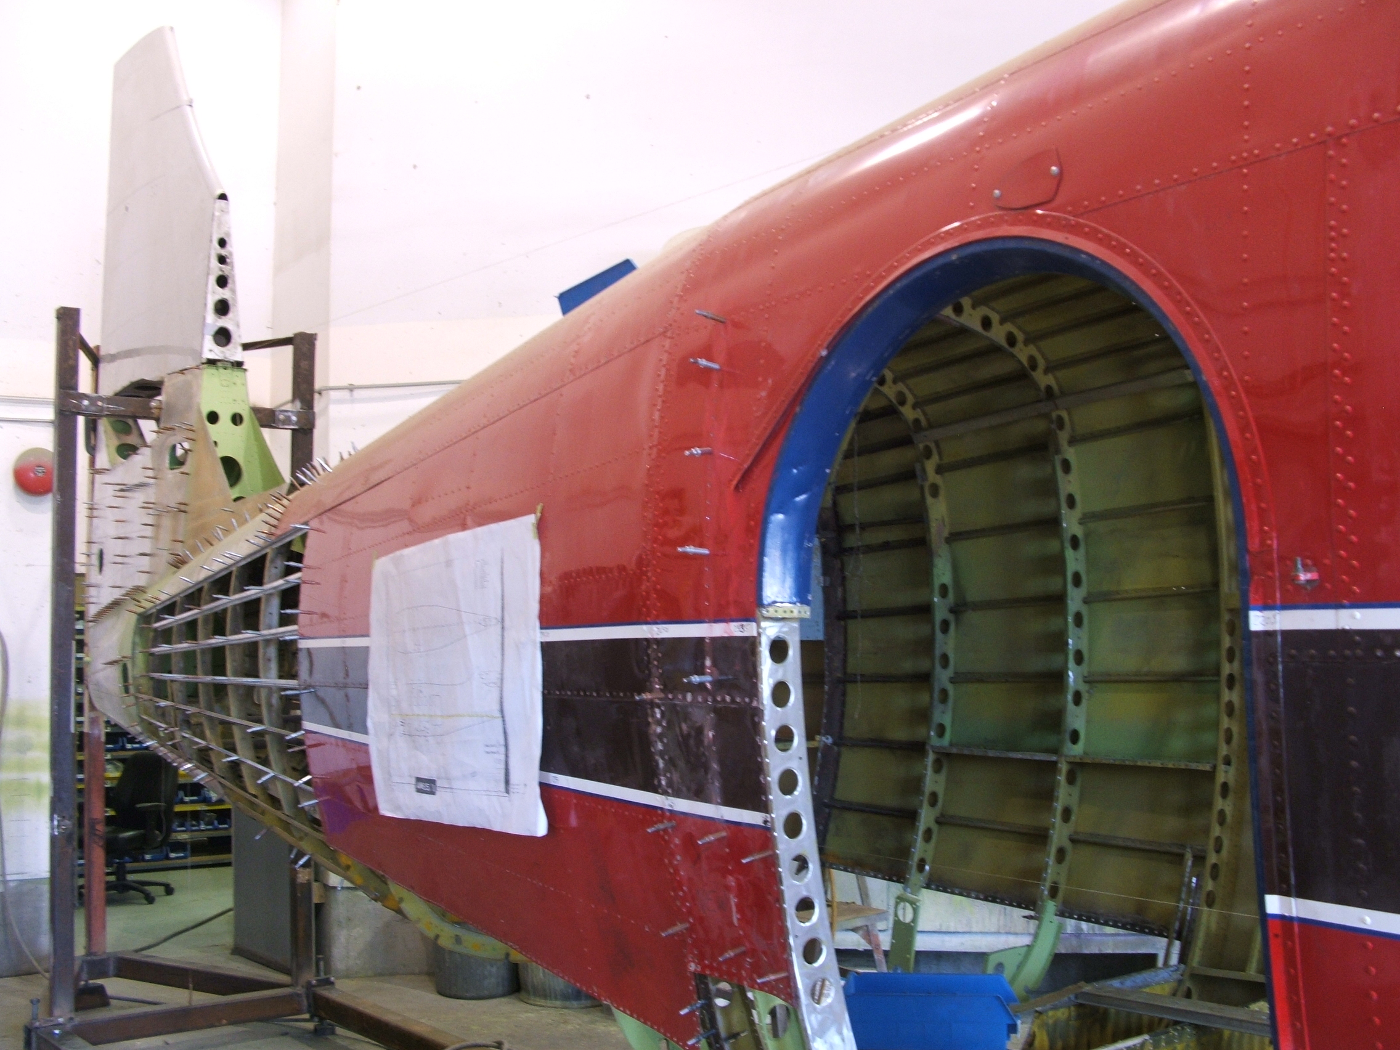
Starting point at Stolairus’ hangar…

Slide 54
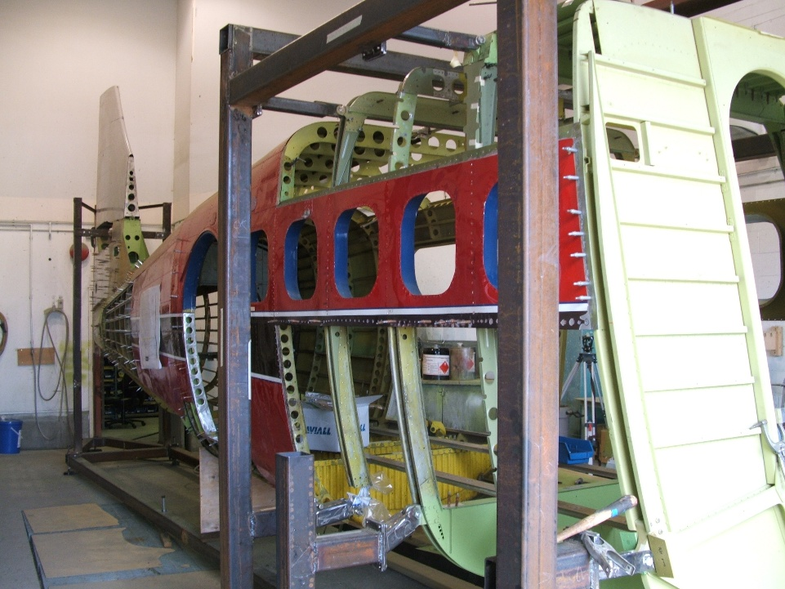

Slide 55
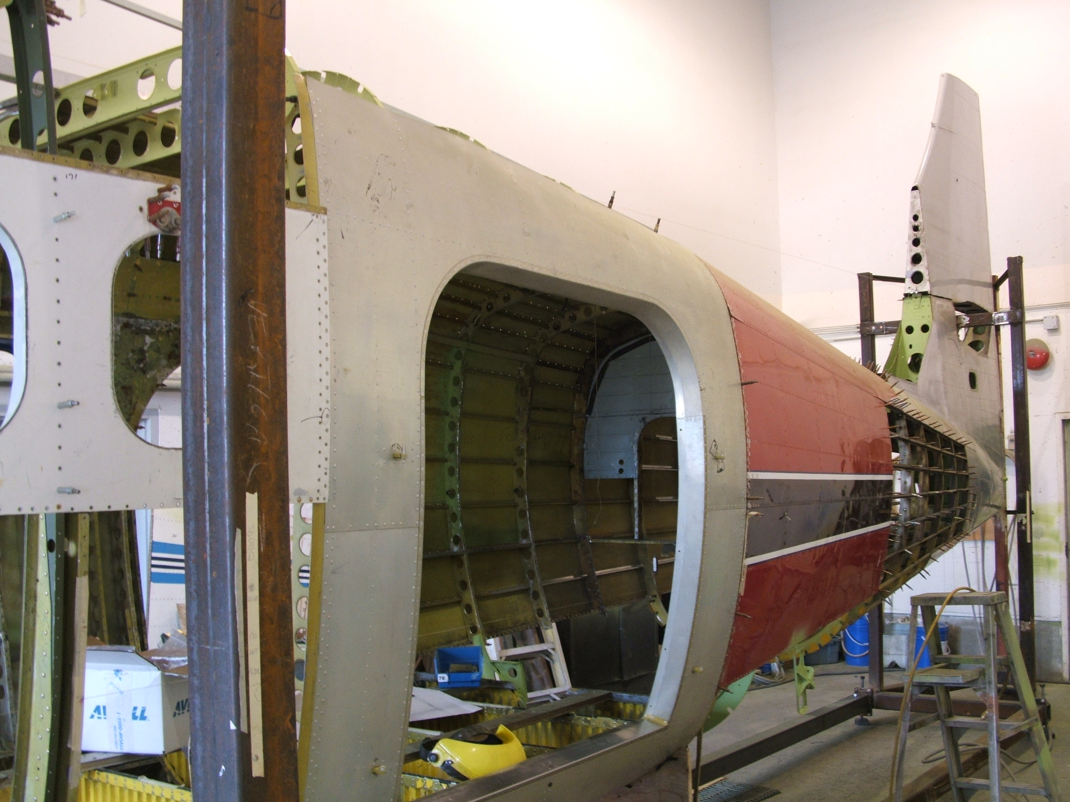

Slide 56
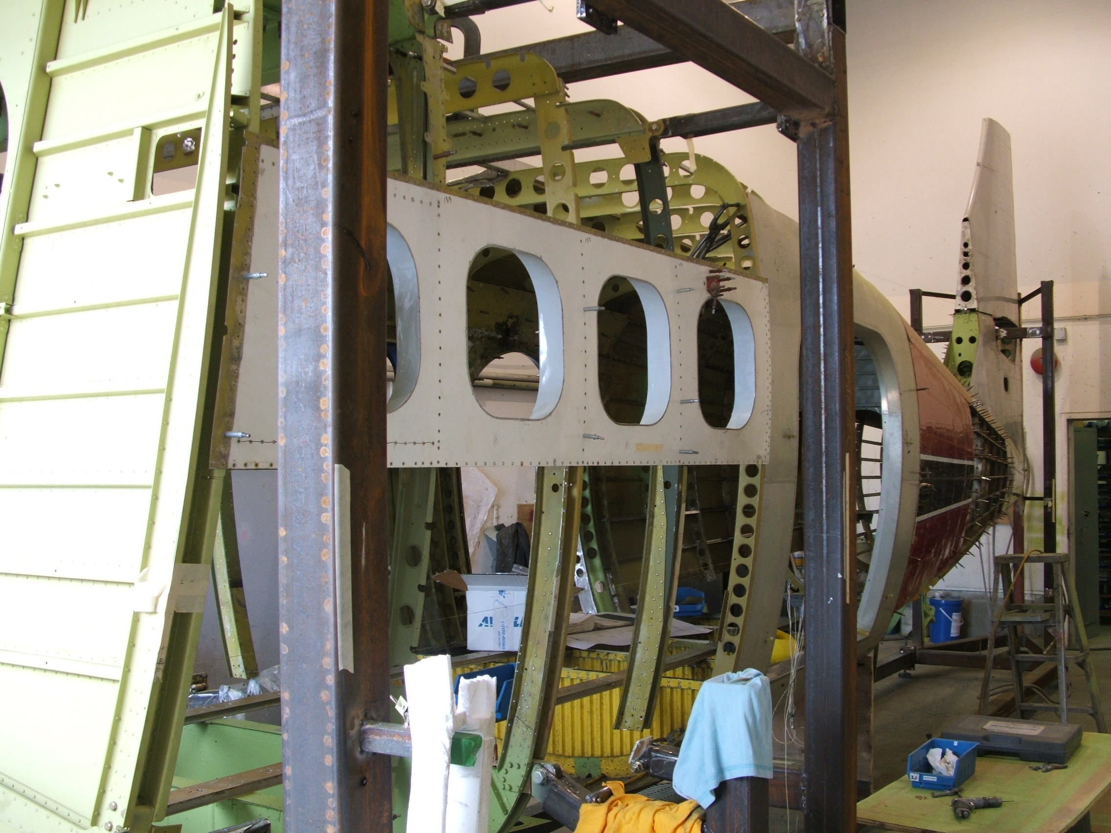

Slide 57
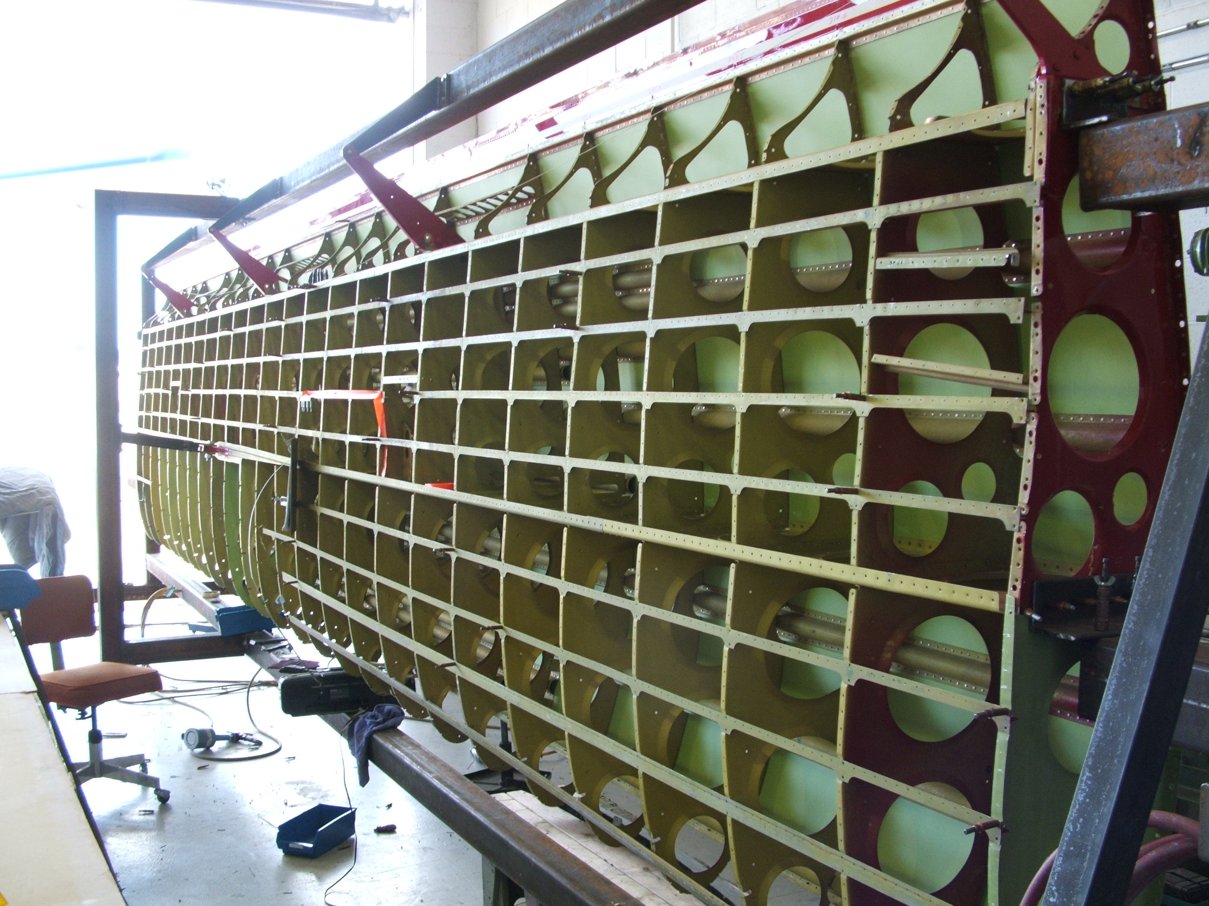

Slide 58
FUSELAGE INTERIOR

Slide 59
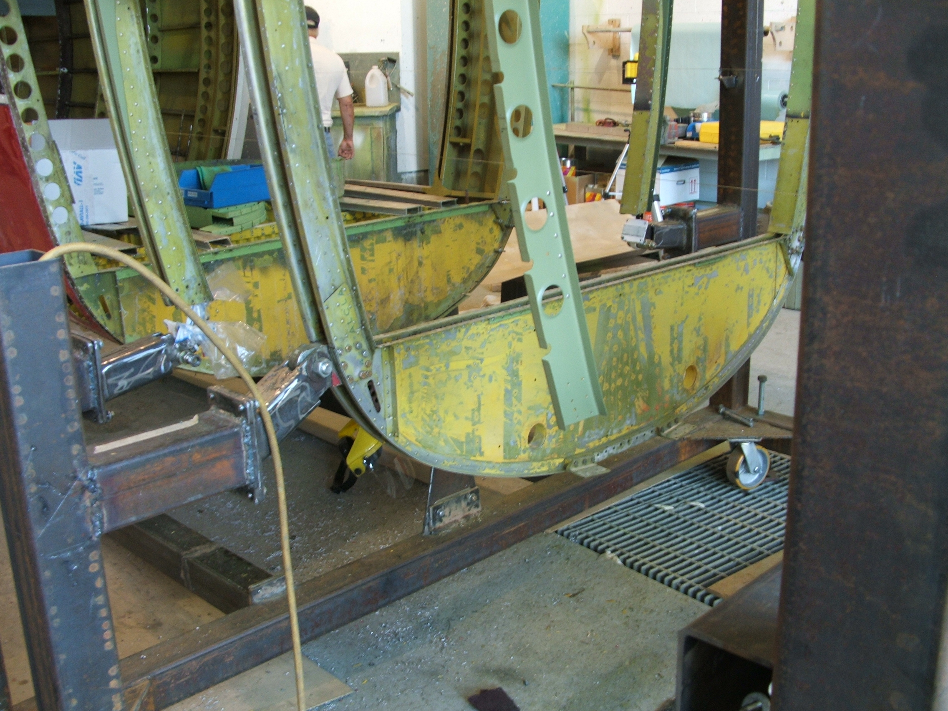

Slide 60
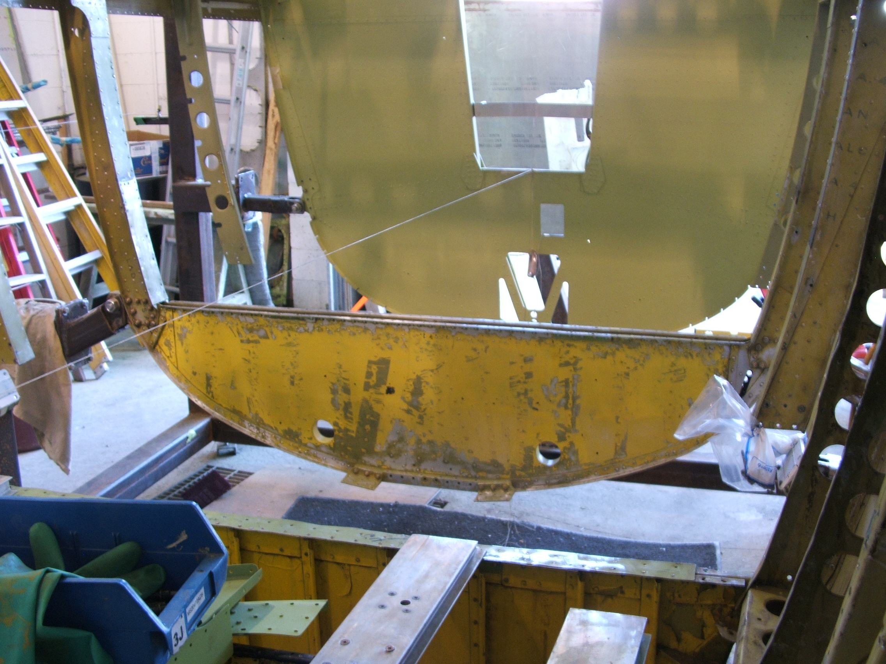

Slide 61
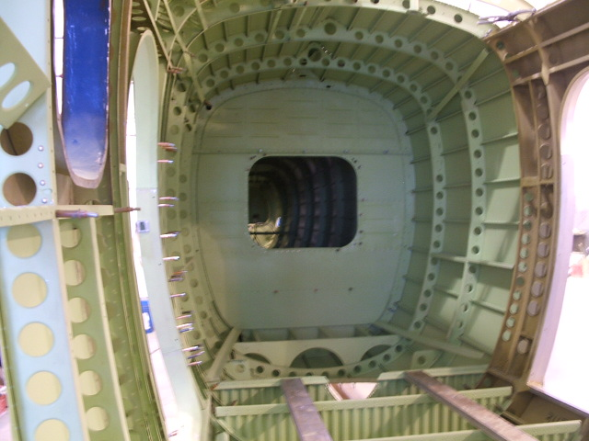

Slide 62
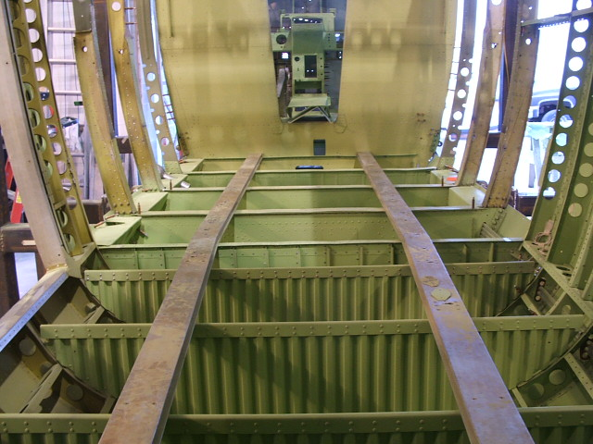

Slide 63
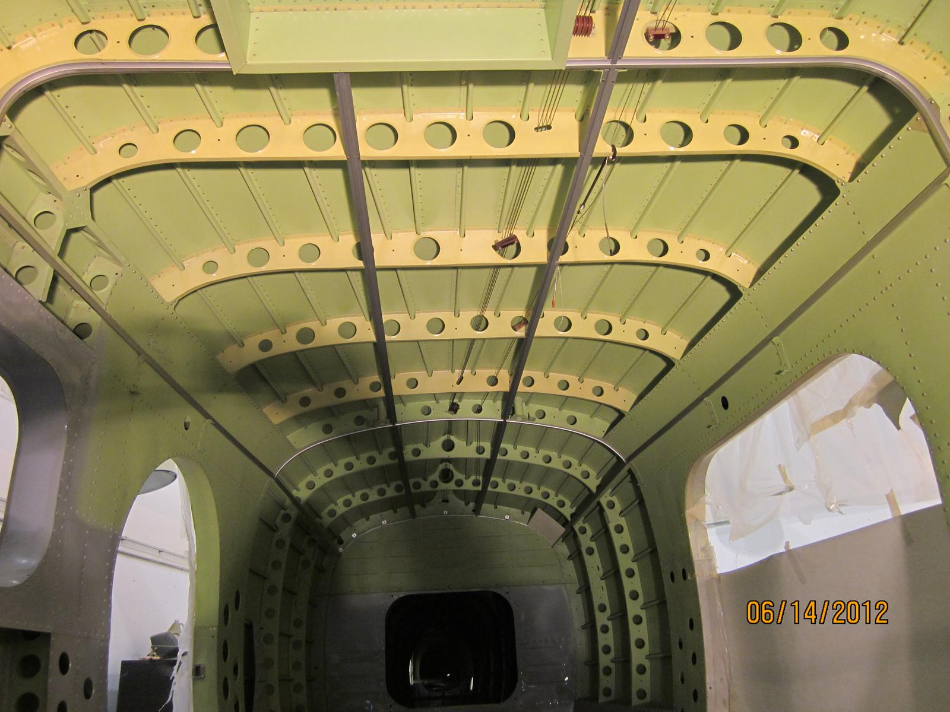

Slide 64
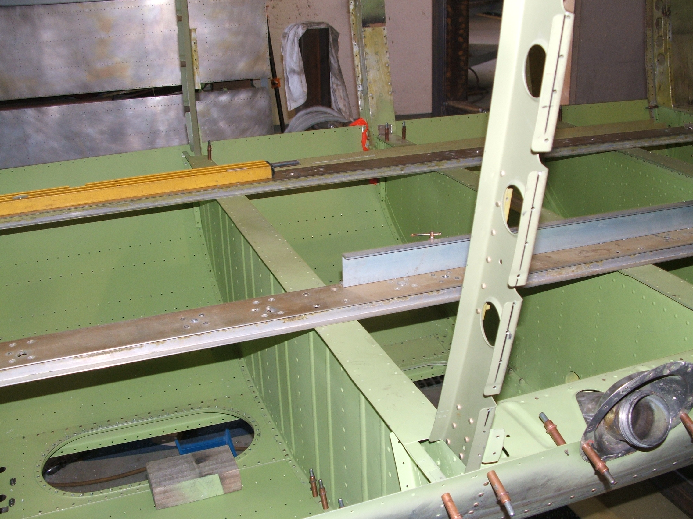

Slide 65
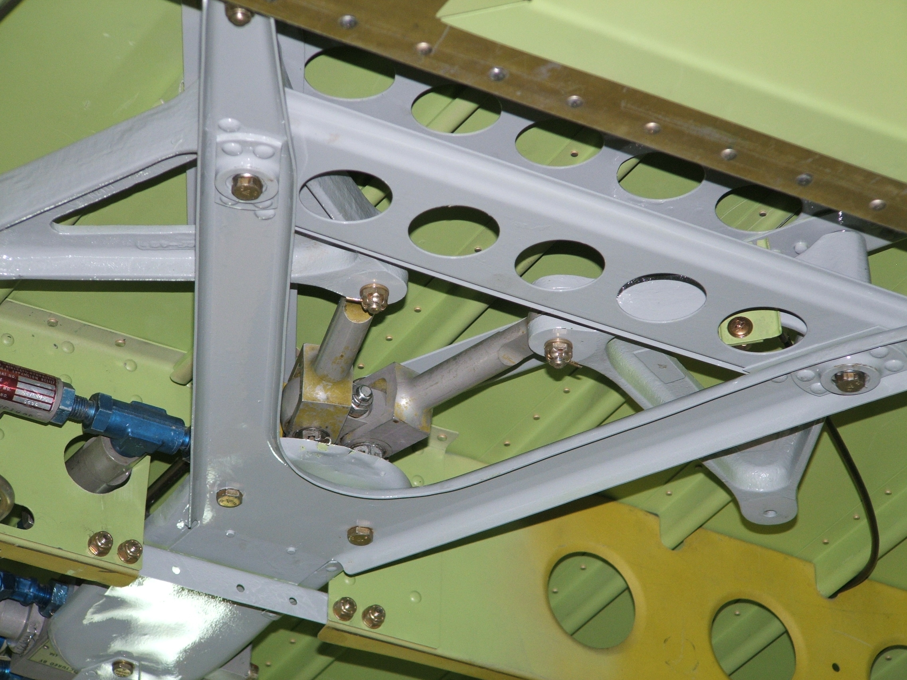
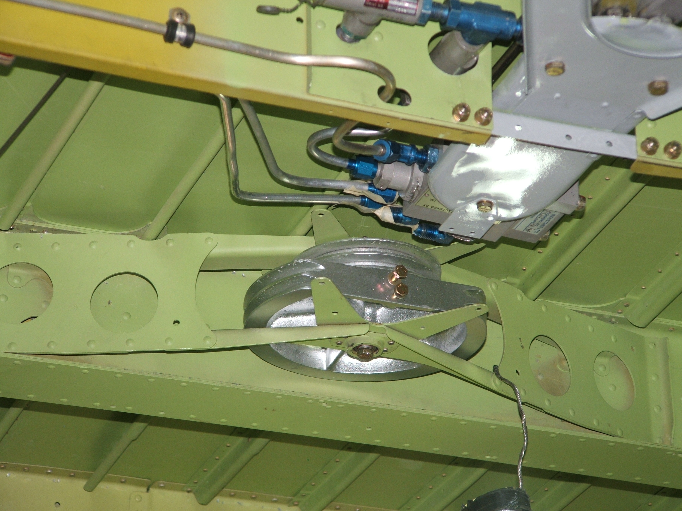
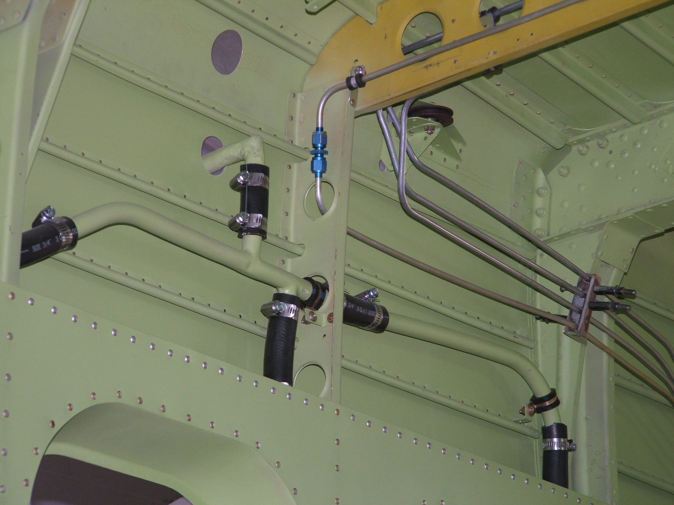
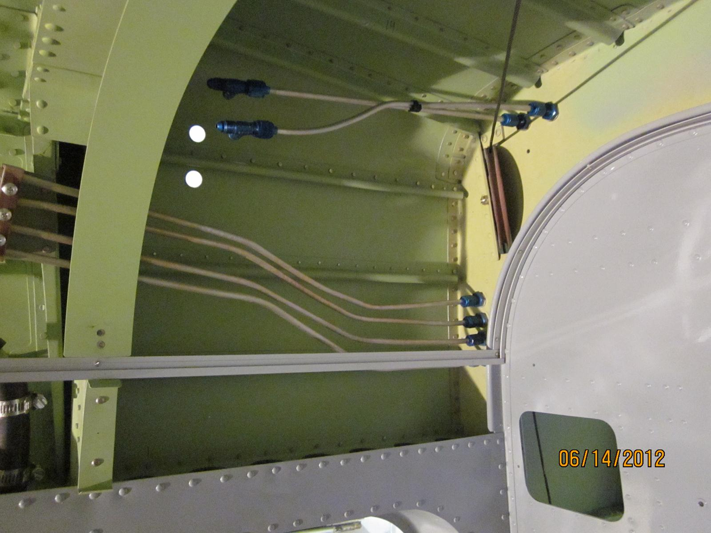

Slide 66
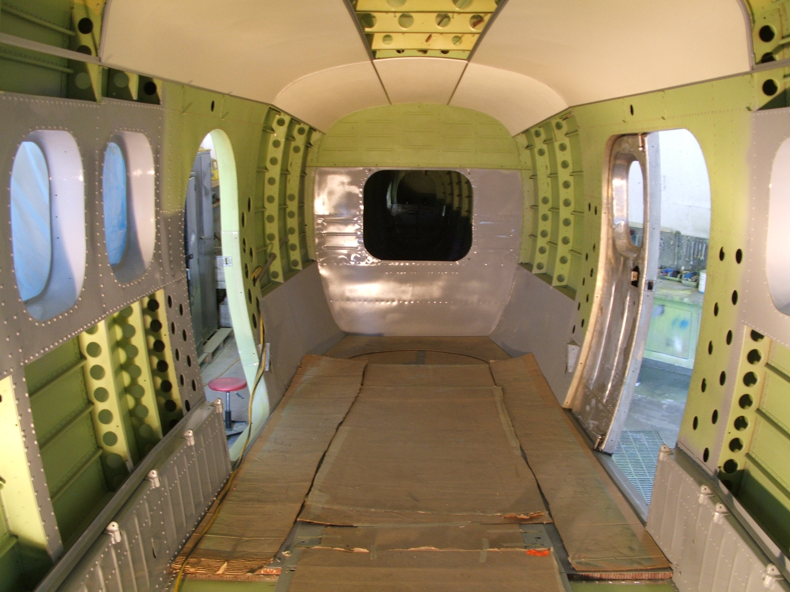

Slide 67
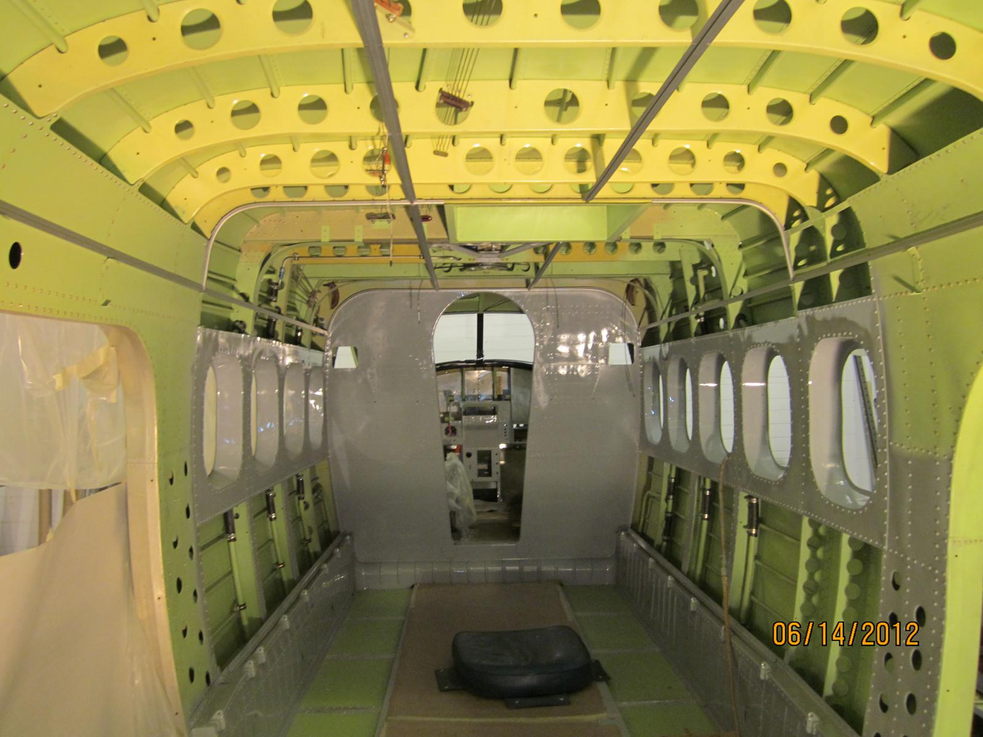

Slide 68
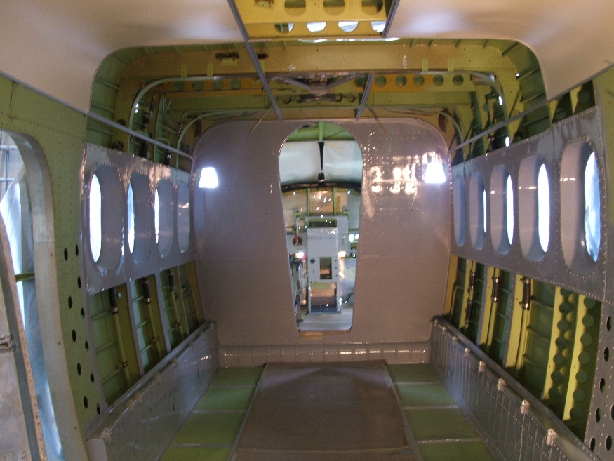

Slide 69
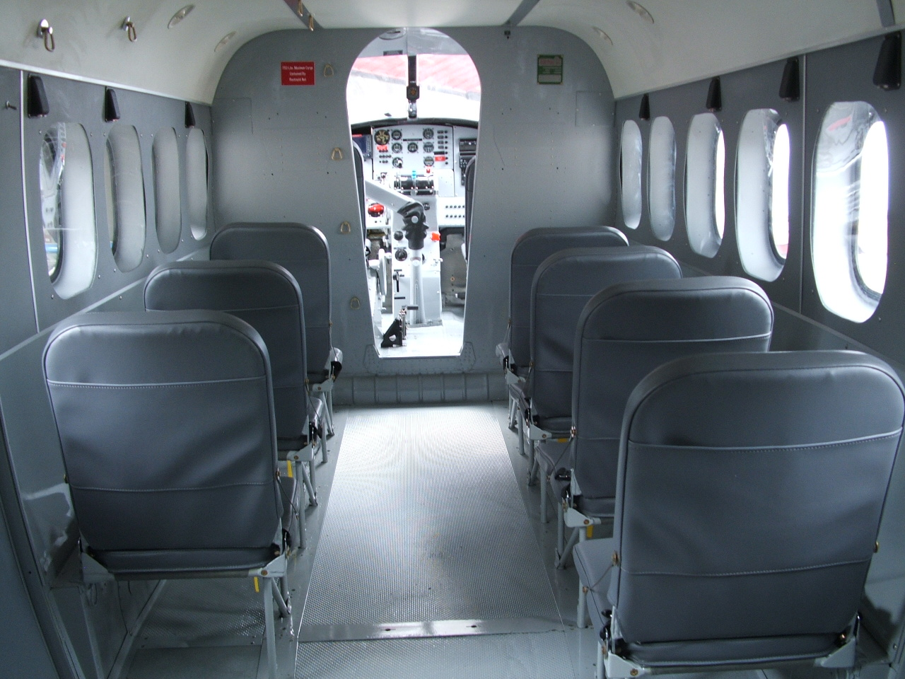

Slide 70
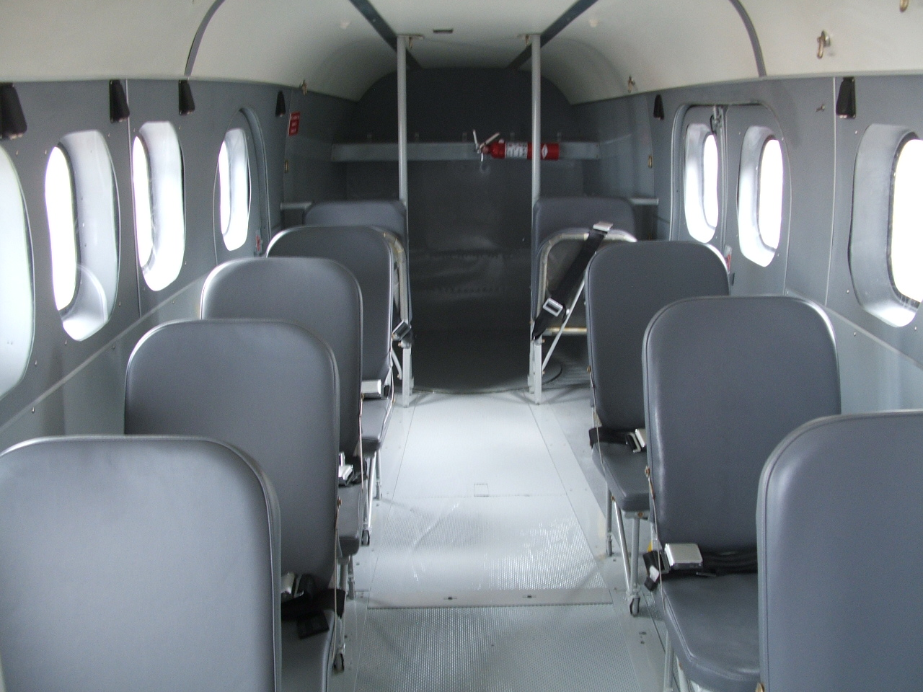

Slide 71
TAIL SECTION
INTERIOR REAR BULKHEAD
TO TAIL

Slide 72
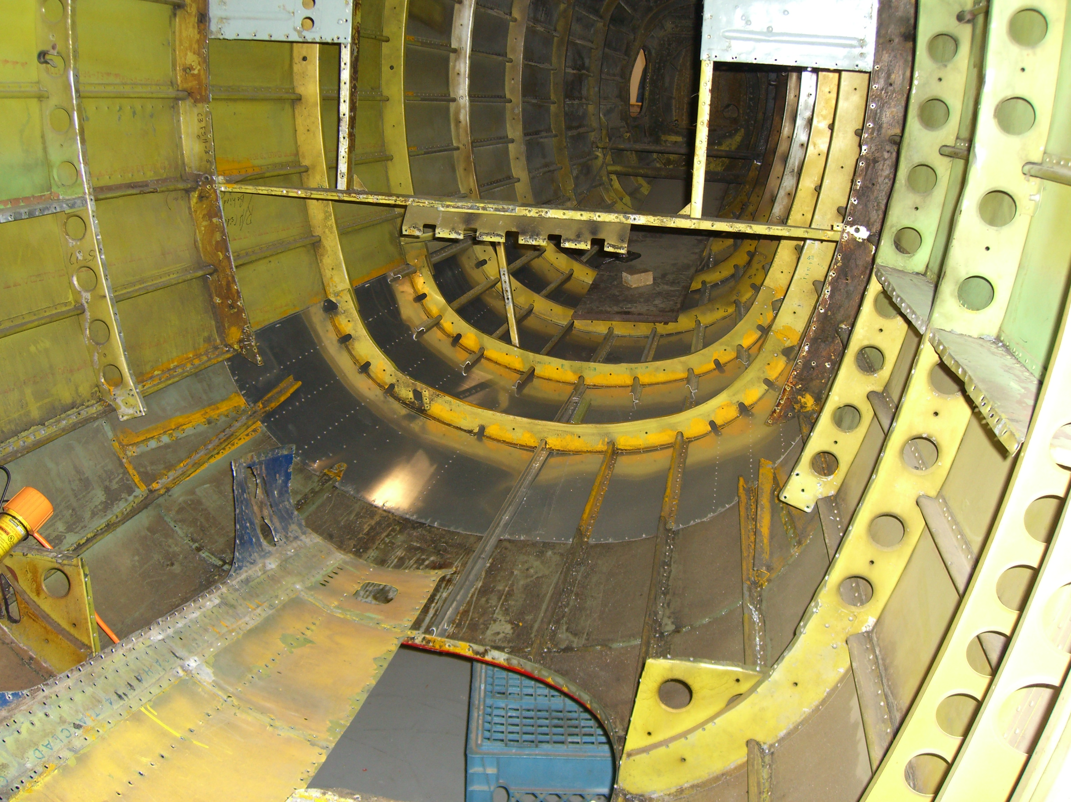

Slide 73
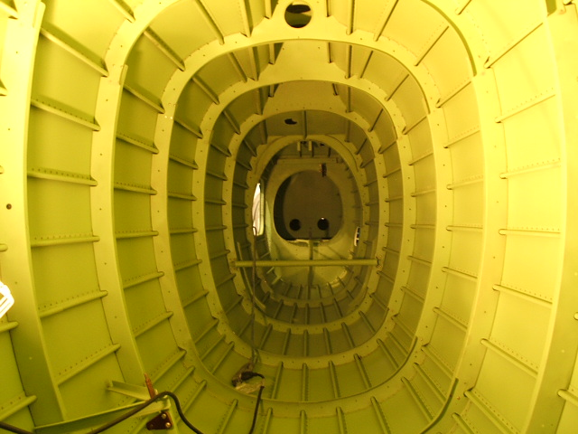

Slide 74
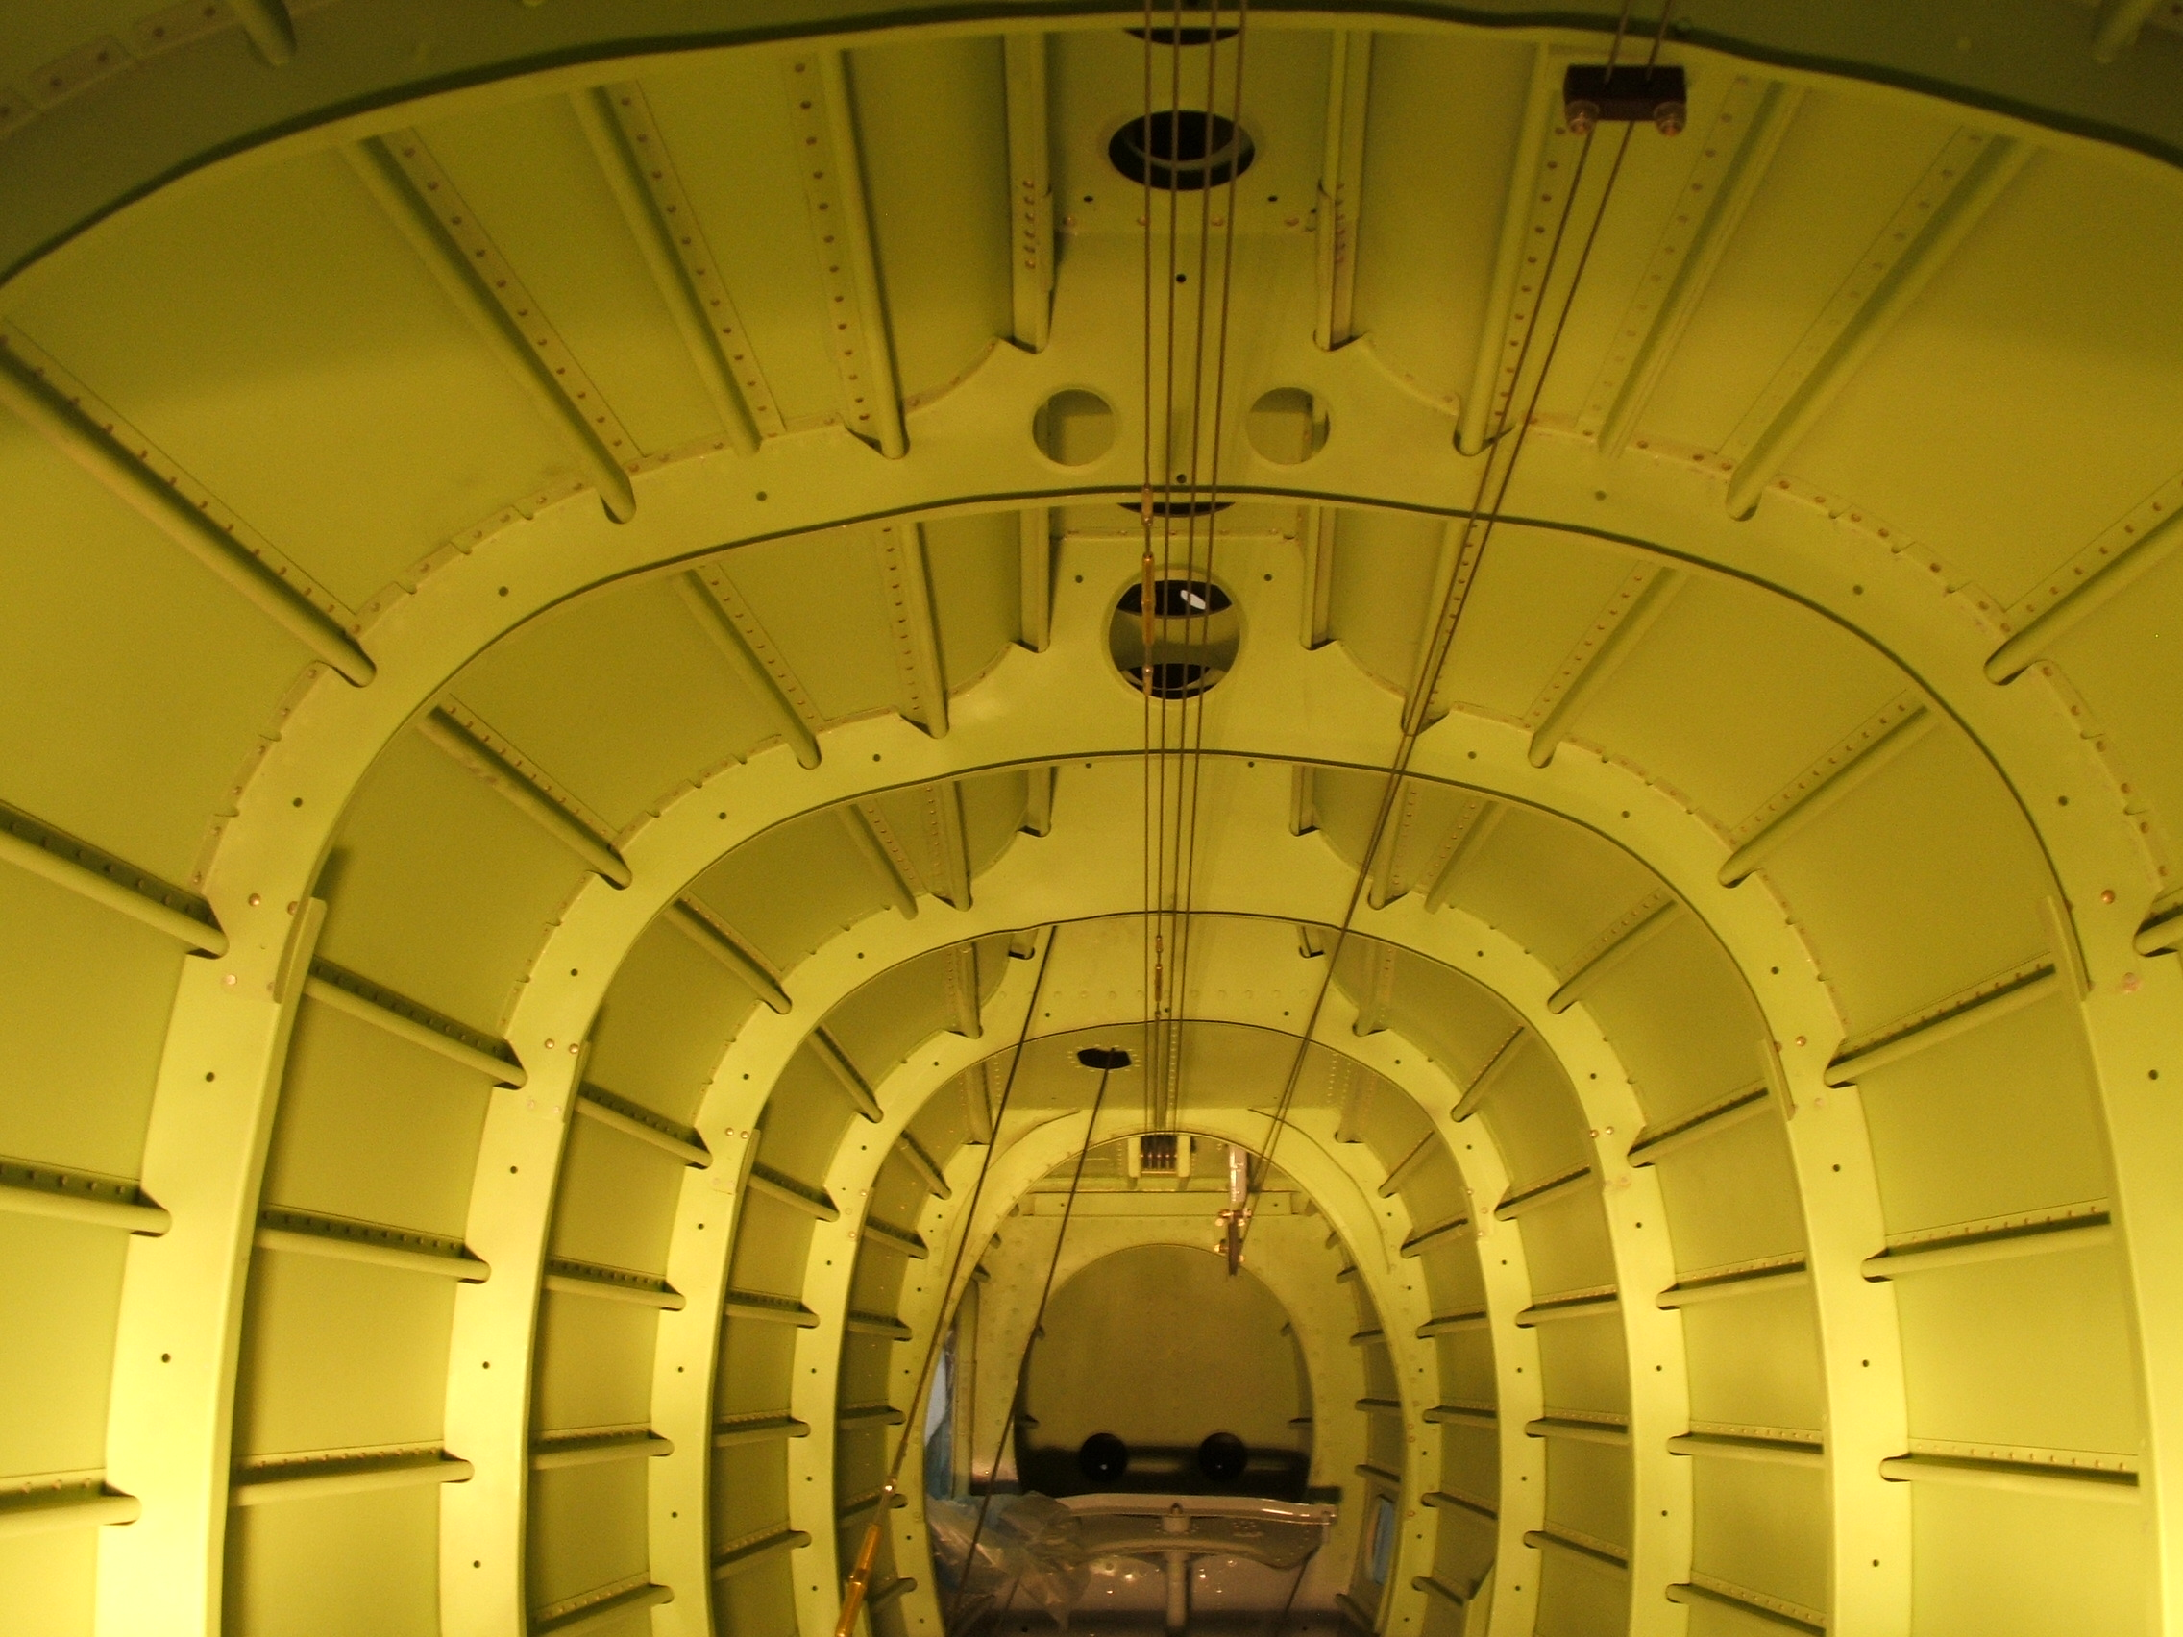

Slide 75
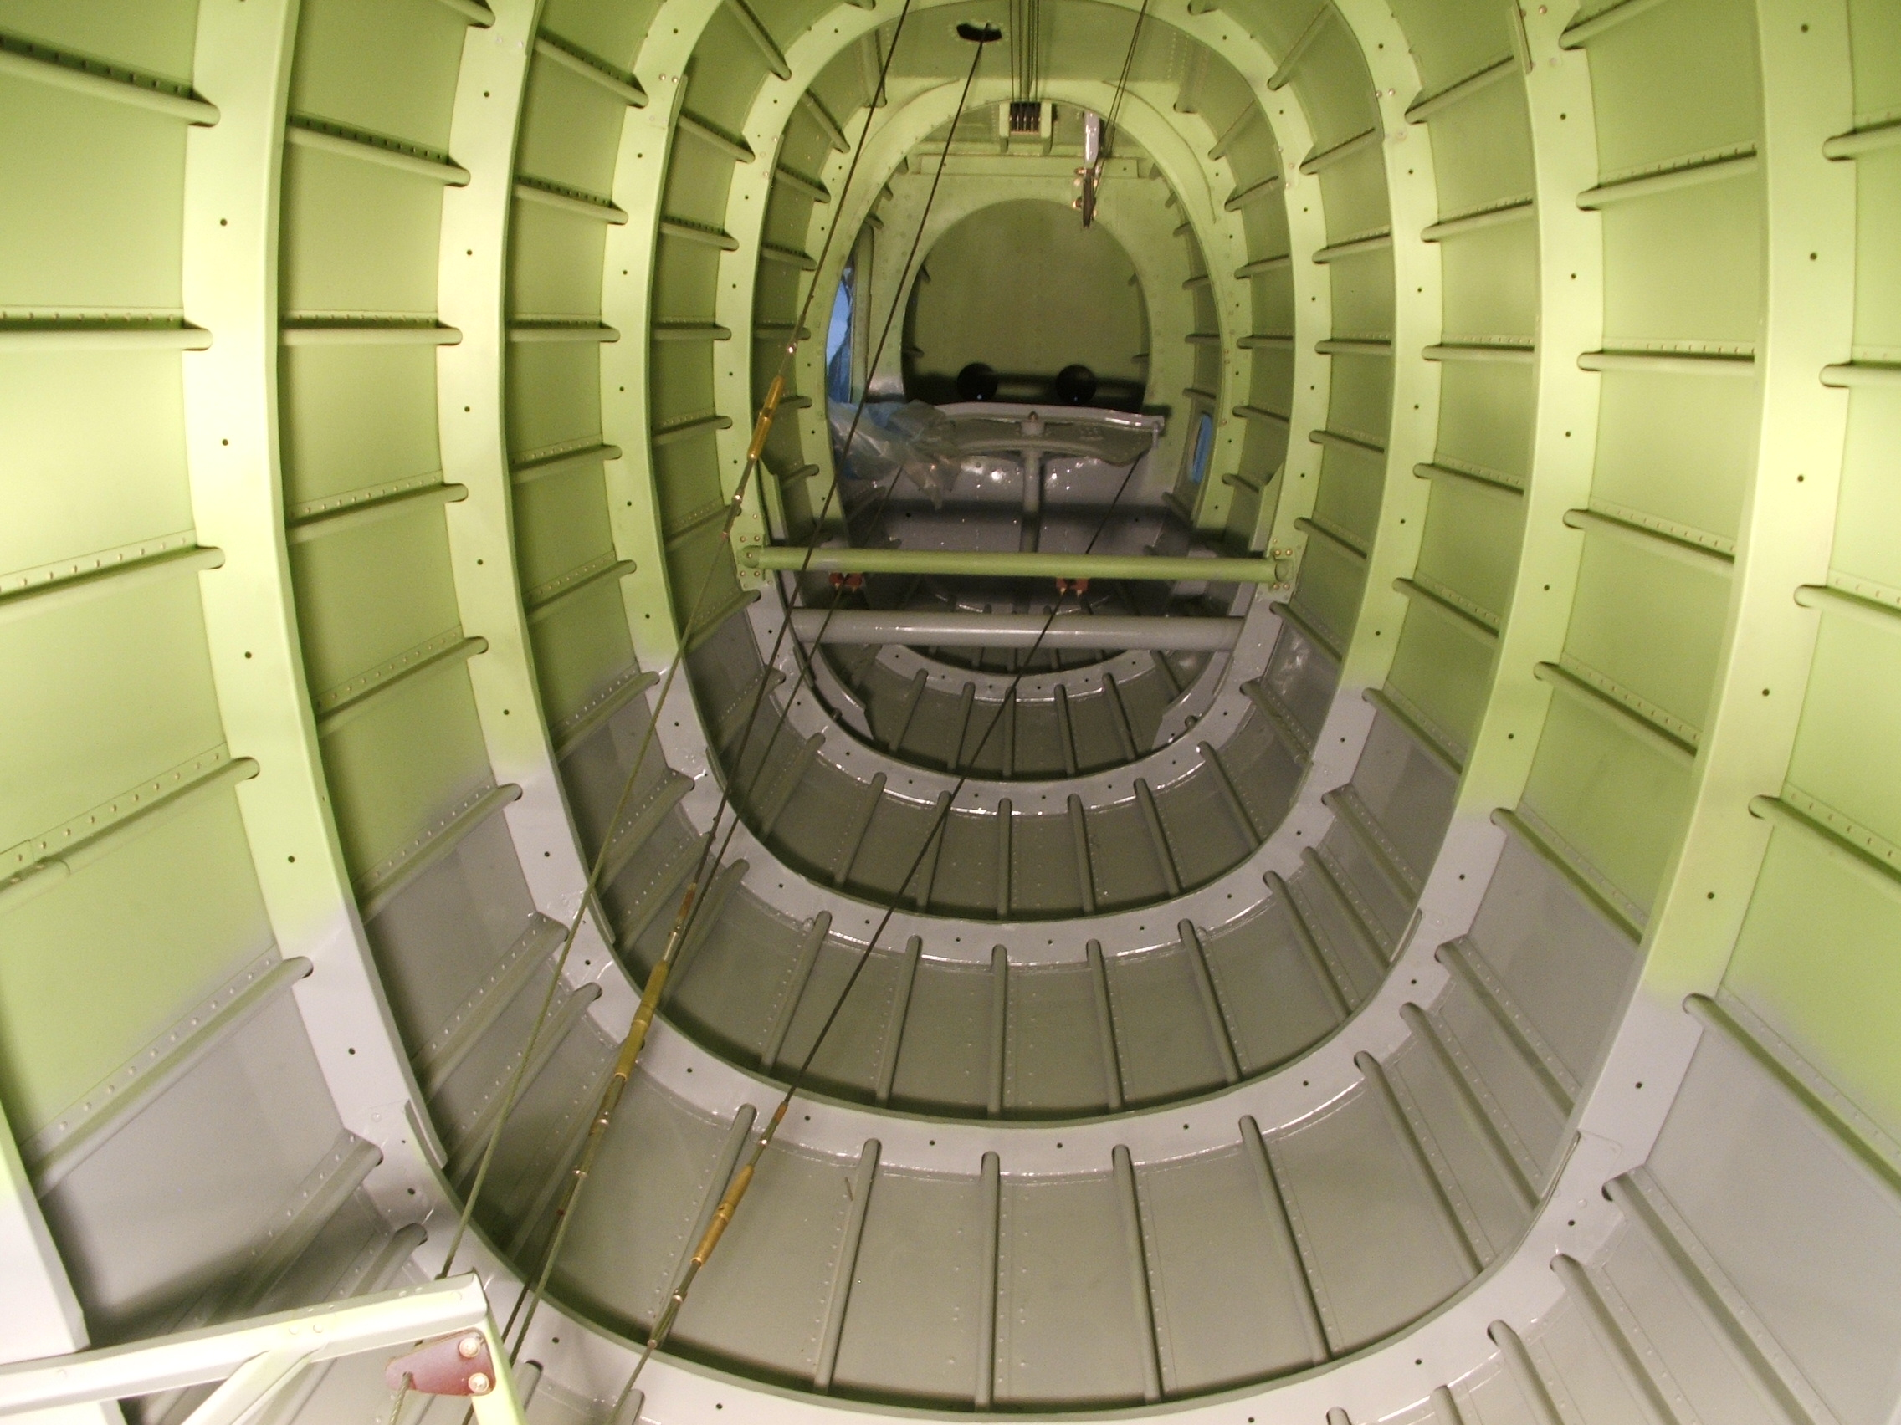

Slide 76
COCKPIT SECTION

Slide 77
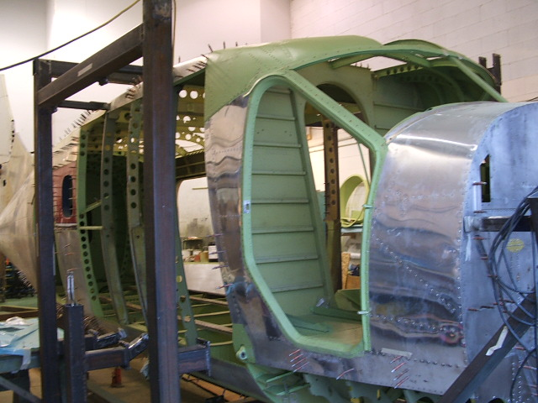

Slide 78
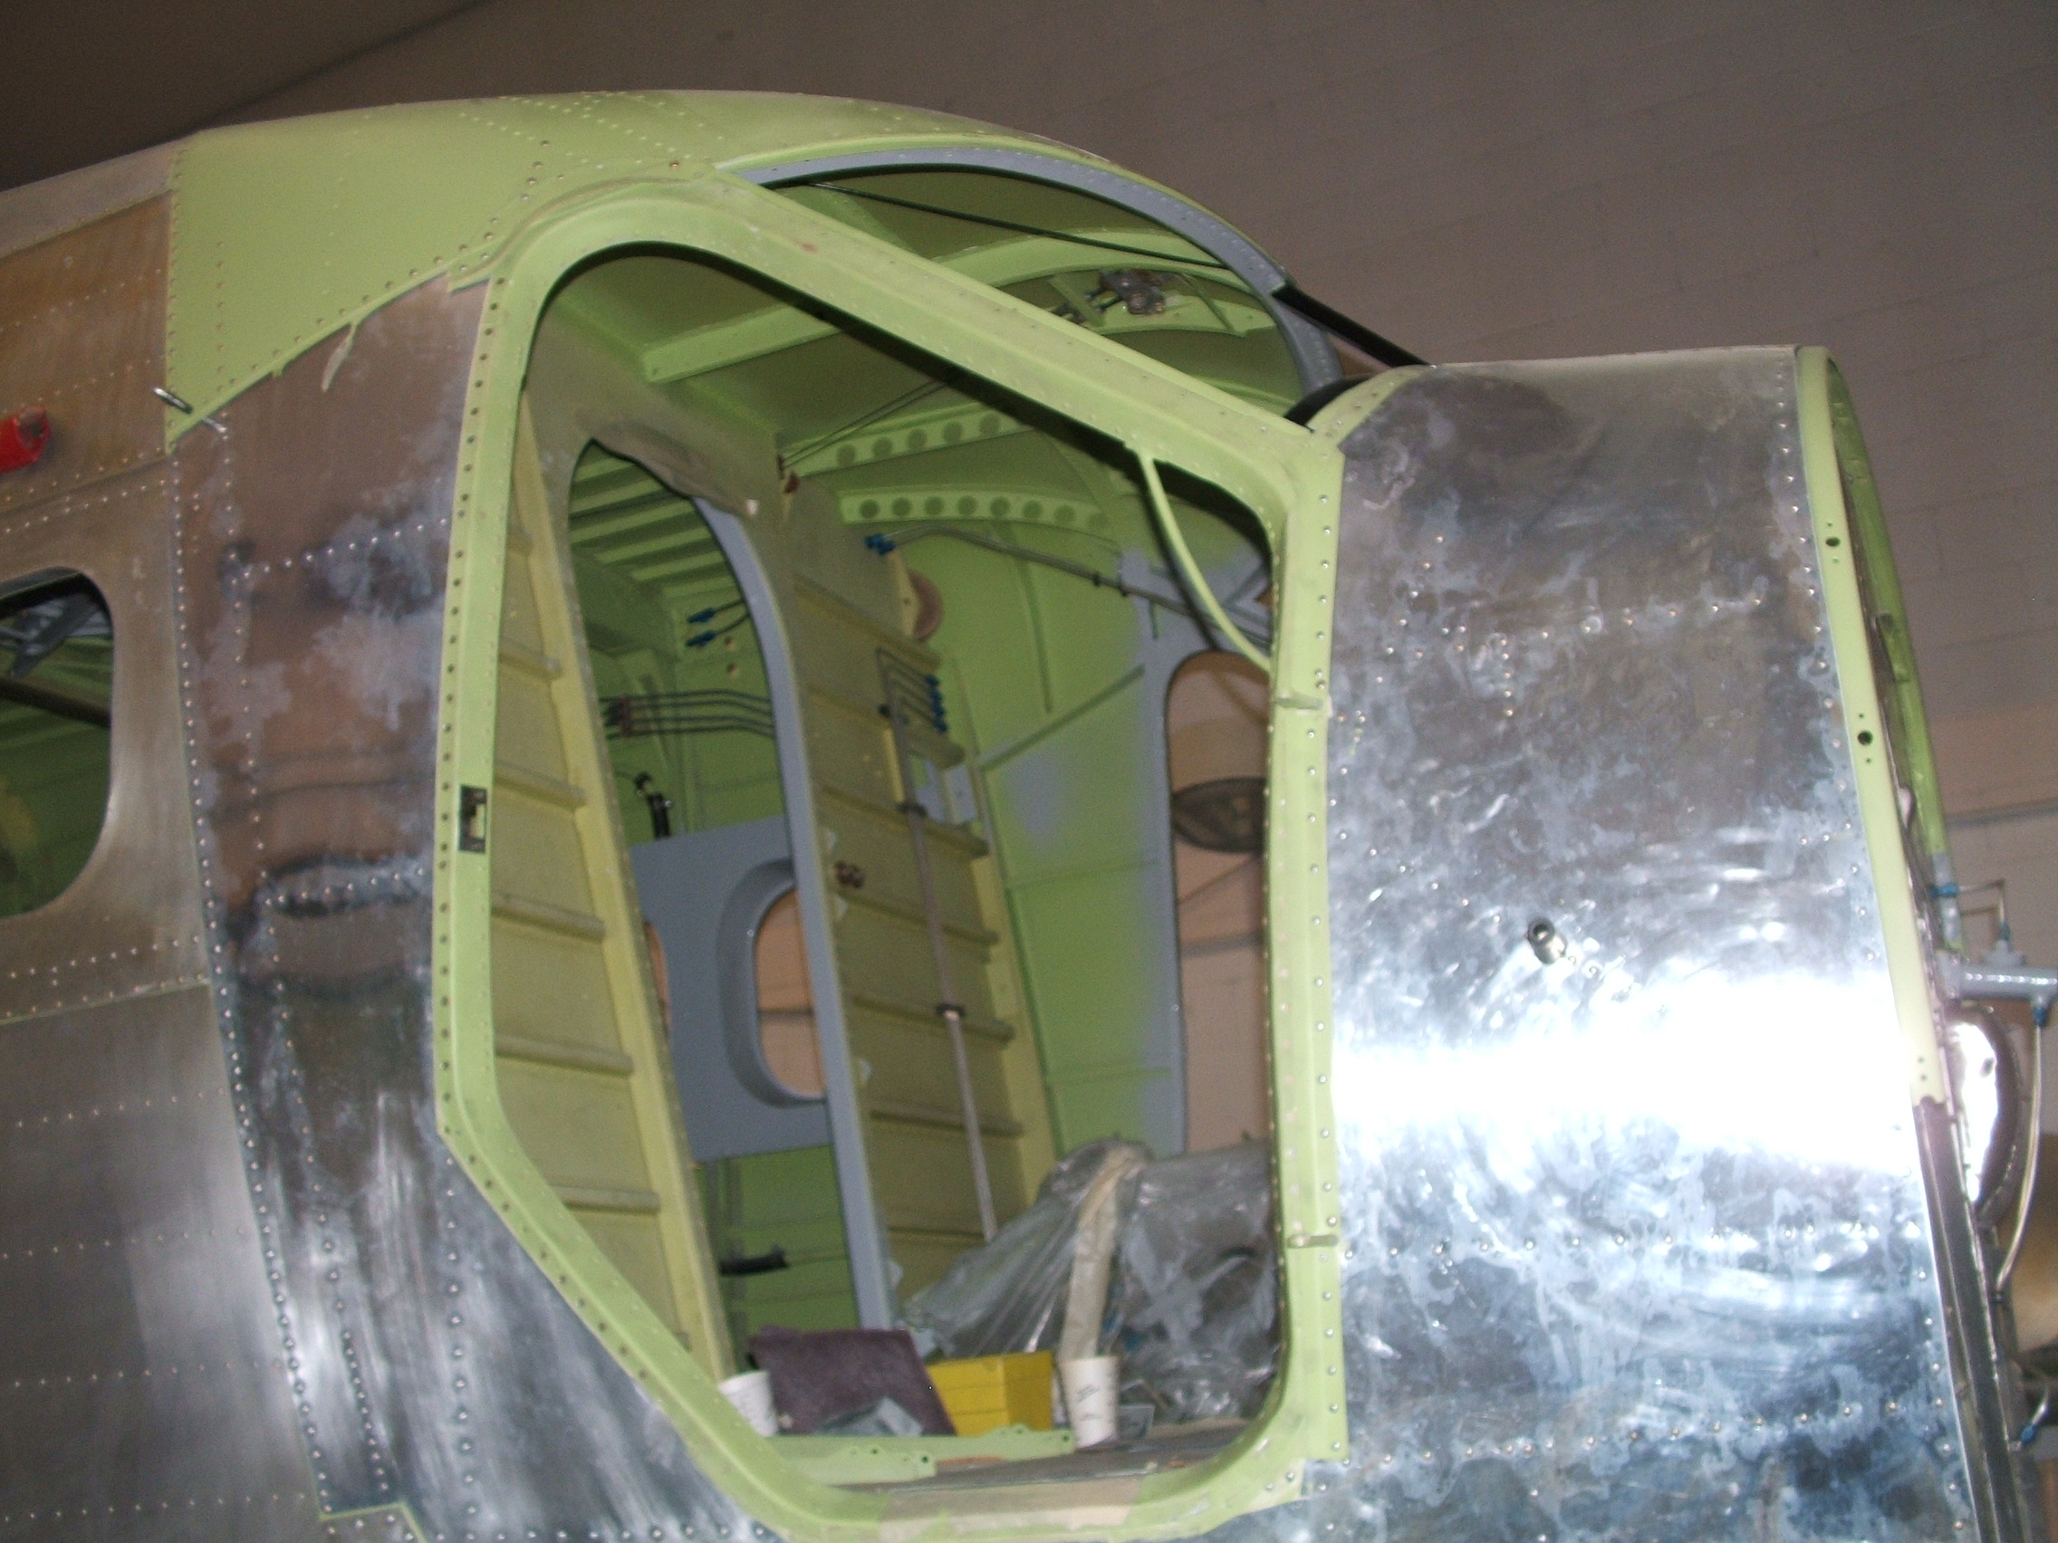

Slide 79
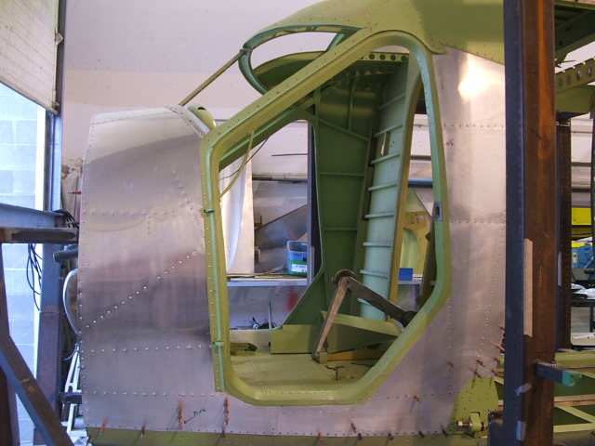

Slide 80
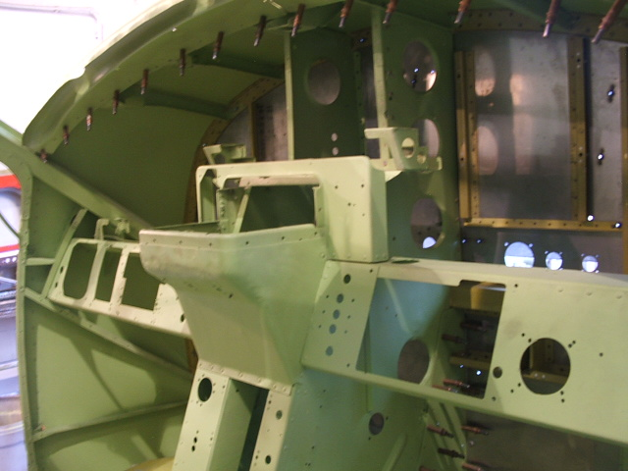

Slide 81
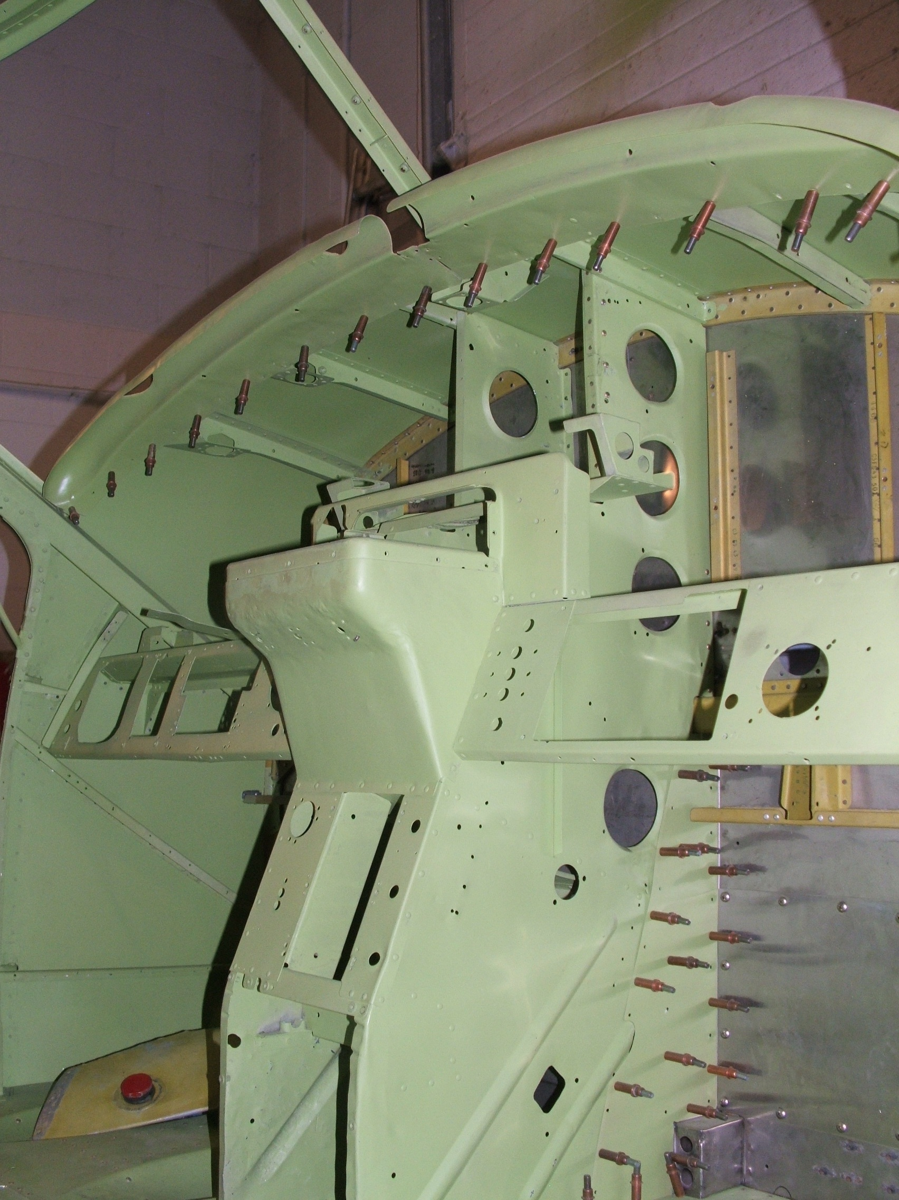

Slide 82
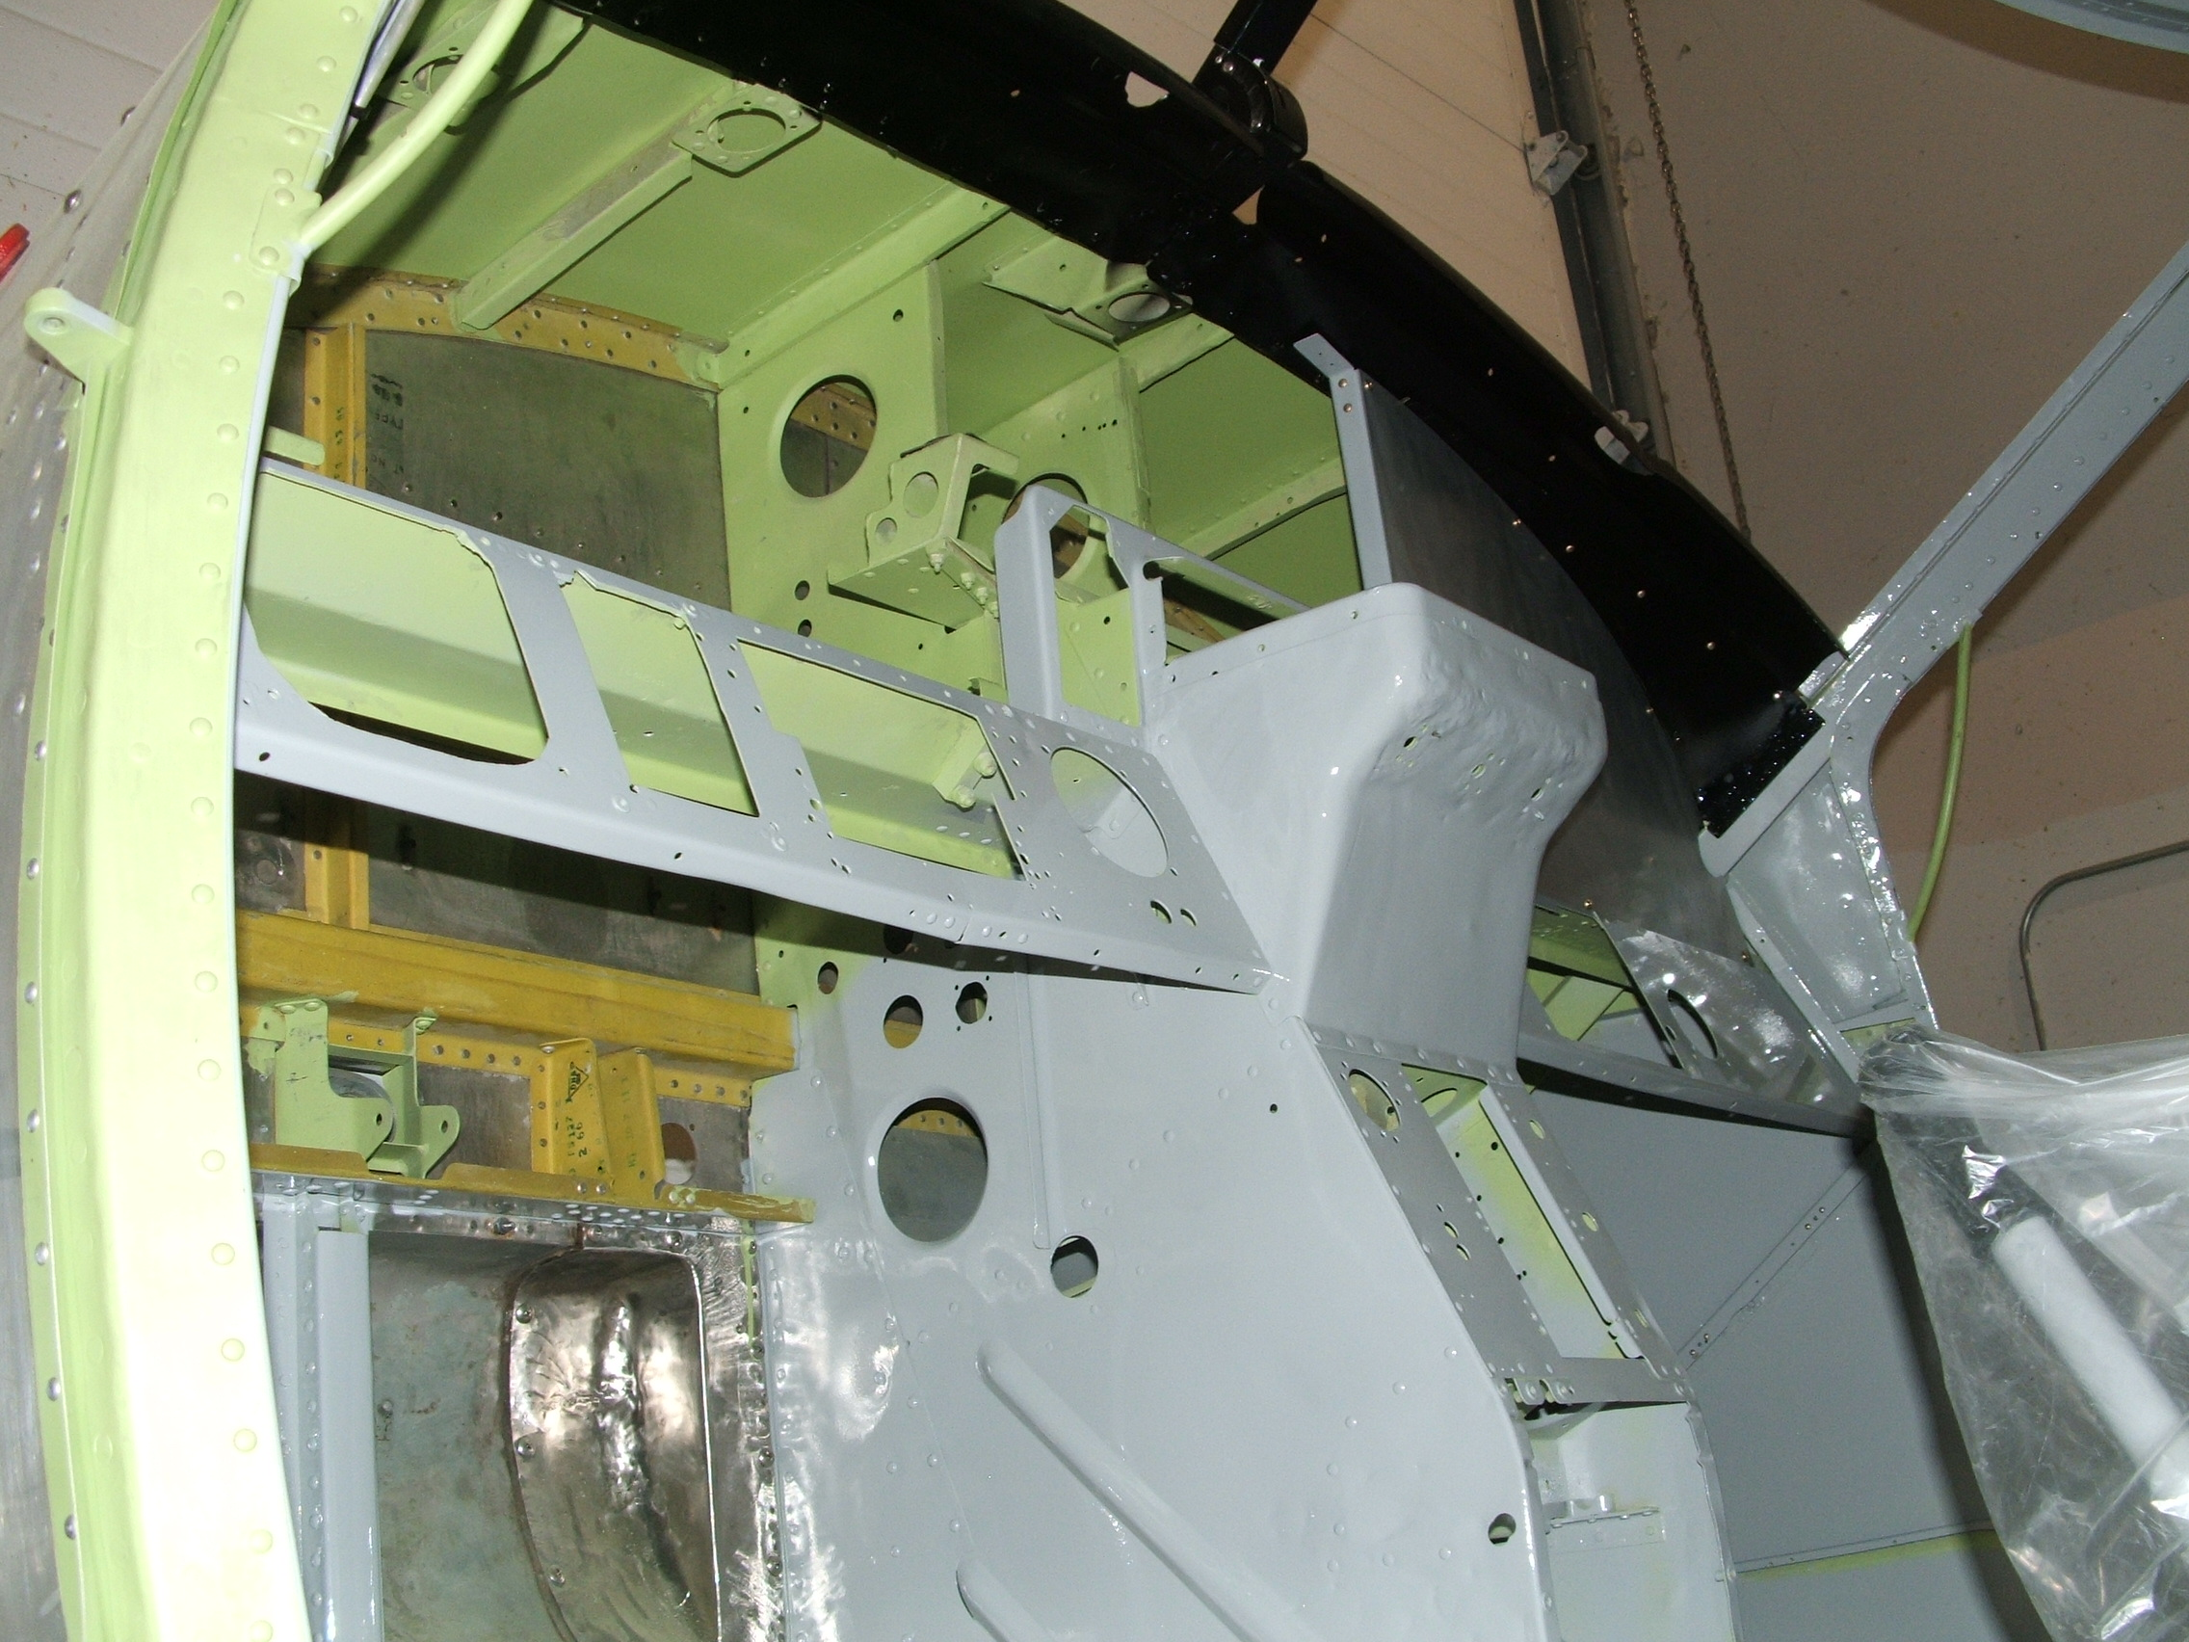

Slide 83
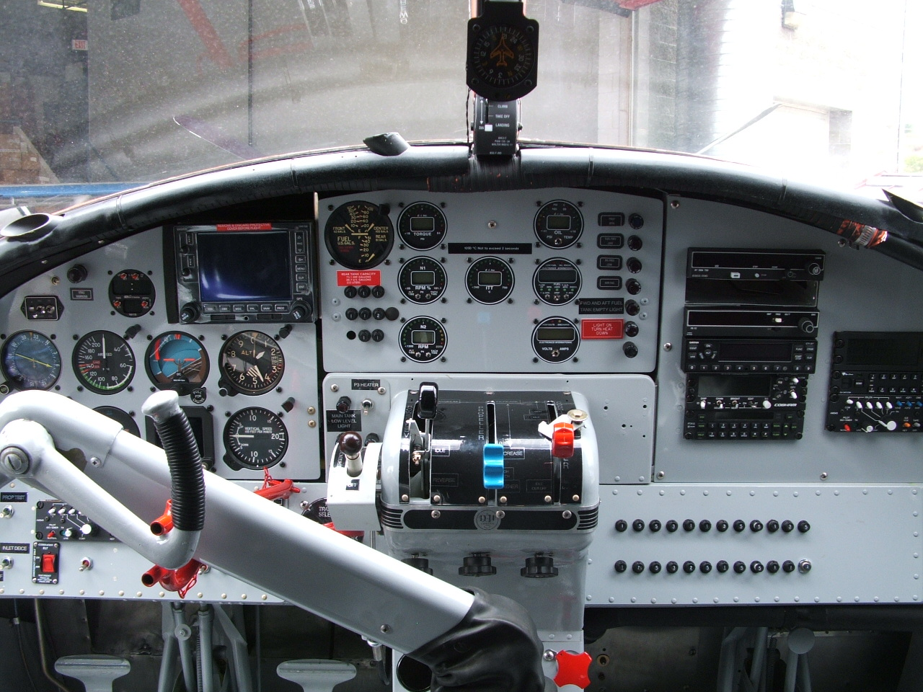

Slide 84
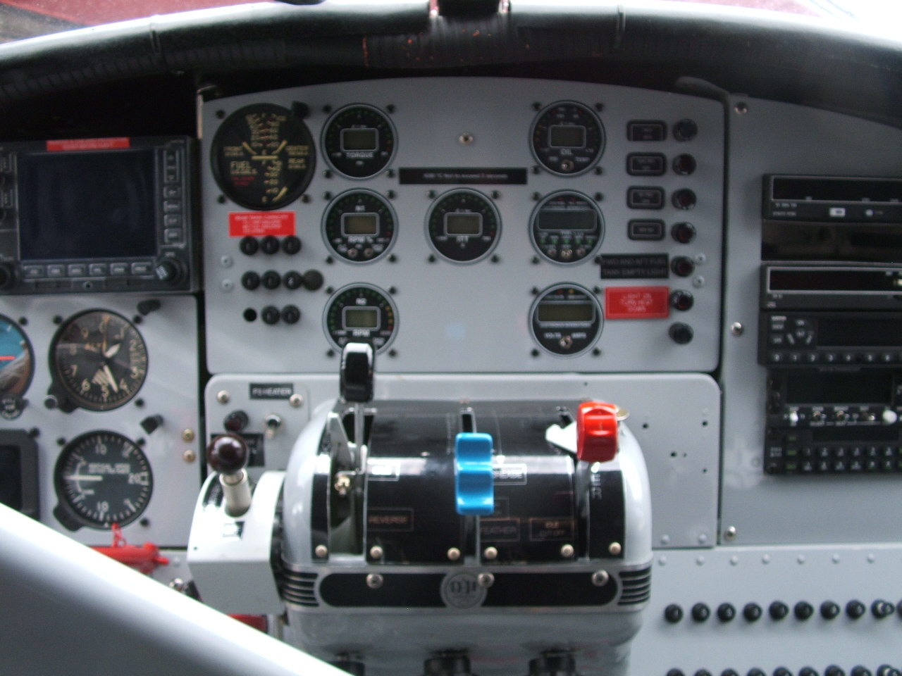

Slide 85
EXTERIOR FUSELAGE

Slide 86


Slide 88
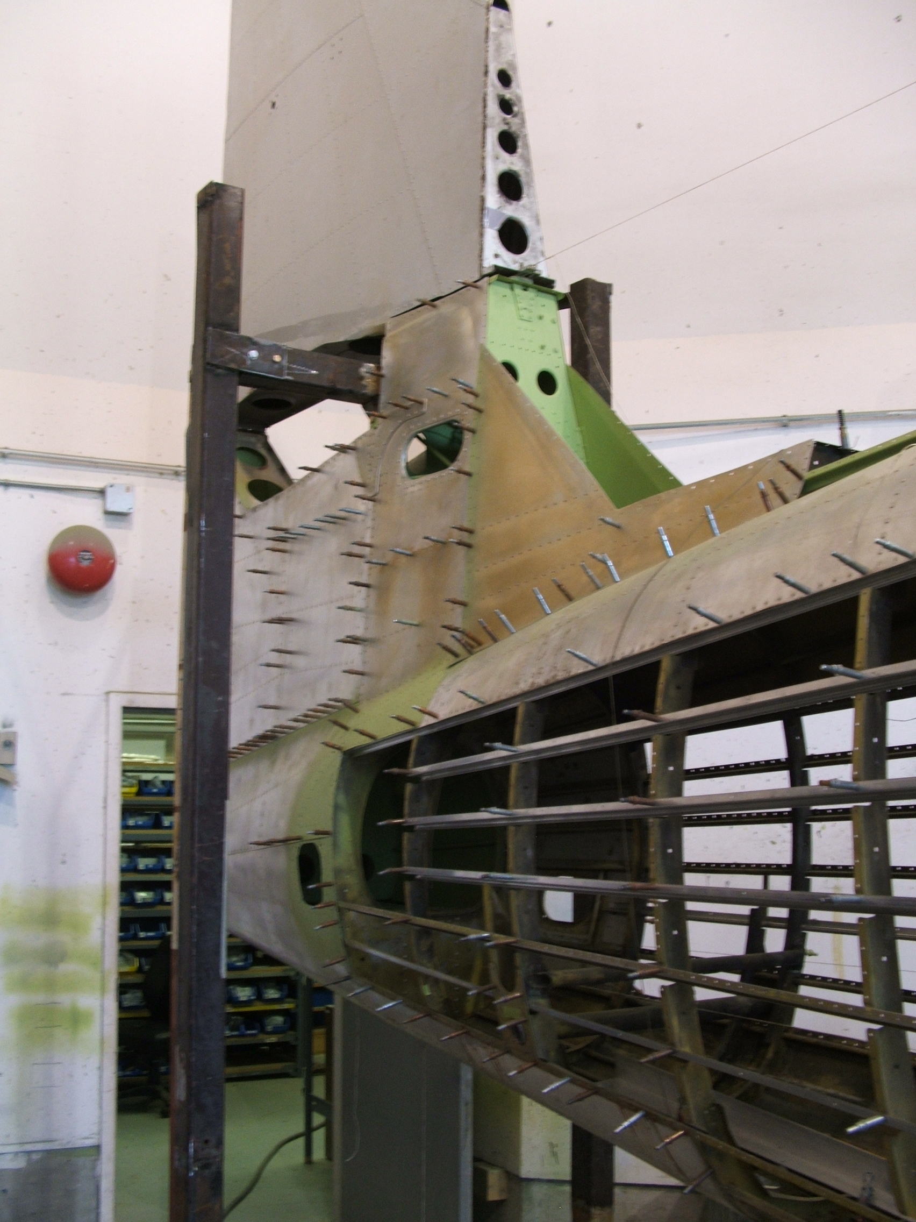

Slide 89


Slide 90


Slide 91


Slide 93


Slide 95


Slide 96


Slide 97

Ready for some paint …

Slide 98


Slide 99


Slide 100


Slide 101


Slide 102


Slide 103


Slide 104


Slide 105


Slide 106


Slide 107


Slide 108


Slide 109


Slide 110


Slide 111


Slide 112


Slide 113


Slide 114
GOOD FOR ANOTHER 59 YEARS!

